Slide 1
Dynamic time warping
Time Series Classification
Slides based on:
vlm1.uta.edu/~athitsos/courses/cse6363_spring2017/lectures/15_dtw.pptx
https://www.lancaster.ac.uk/media/lancaster-university/content-assets/documents/stor-i/interns-docs/2017/Jonathan-Presentation.pdf

Slide 2
Time Series
A time series is a sequence of observations made over time.
Examples:
Stock market prices (for a single stock every day)
Heart rate of a patient over time
Position of one or multiple people/cars/airplanes over time
Speech: represented as a sequence of audio measurements at discrete time steps
A musical melody: represented as a sequence of pairs (note, duration)

Slide 3
Applications of Time Series Classification
Stock market prices (for a single stock every day)
Sell/Hold/Buy?
Heart rate of a patient over time:
a healthy heart, or diseased?
Position of people/cars/airplanes over time
Predict congestion along a route suggested by the GPS
Speech recognition
Music recognition
Sing a tune to your phone, have it recognize the song
Recognize the genre of a song based on how it sounds

Slide 4
Classification of time-series
Two-step process
Measure distance between
test time series and
All time series in the training set
Use k-NN to find closest match
But …
Euclidean Distance is not suitable for time-series (of varying lengths)
So:
Dynamic Time Warping

Slide 5
Time Series Example: Signs
0.5 to 2 million users of American Sign Language (ASL) in the US.
Different regions in the world use different sign languages.
For example, British Sign Language (BSL) is different than American Sign Language.
These languages have vocabularies of thousands of signs.
We will use sign recognition as our example application, as we introduce methods for time series classification.

Slide 6
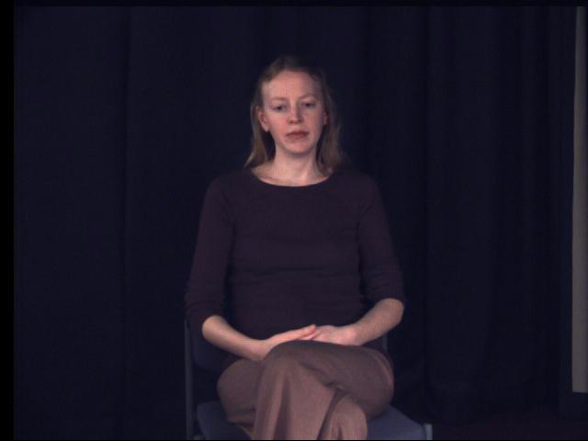
Example: The ASL Sign for "again"

Slide 7
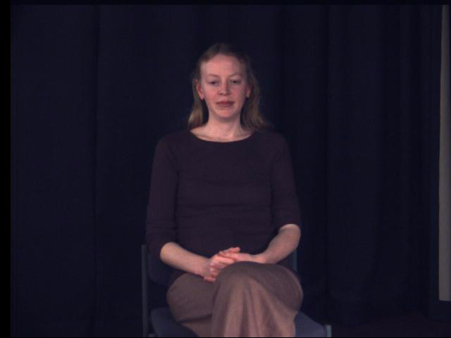
Example: The ASL Sign for "bicycle"

Slide 8
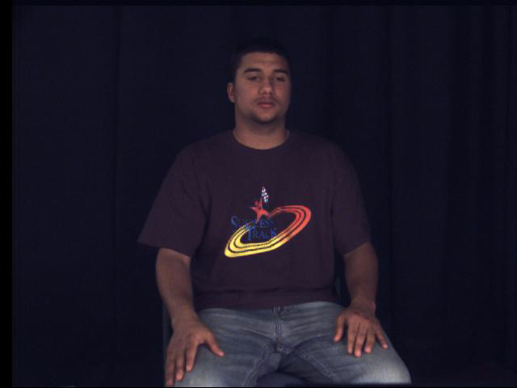
Time Series Classification
Suppose our training set only contains those two signs: "AGAIN" and "BICYCLE".
We get this test sign.
Does it mean "AGAIN", or "BICYCLE"?

Slide 9
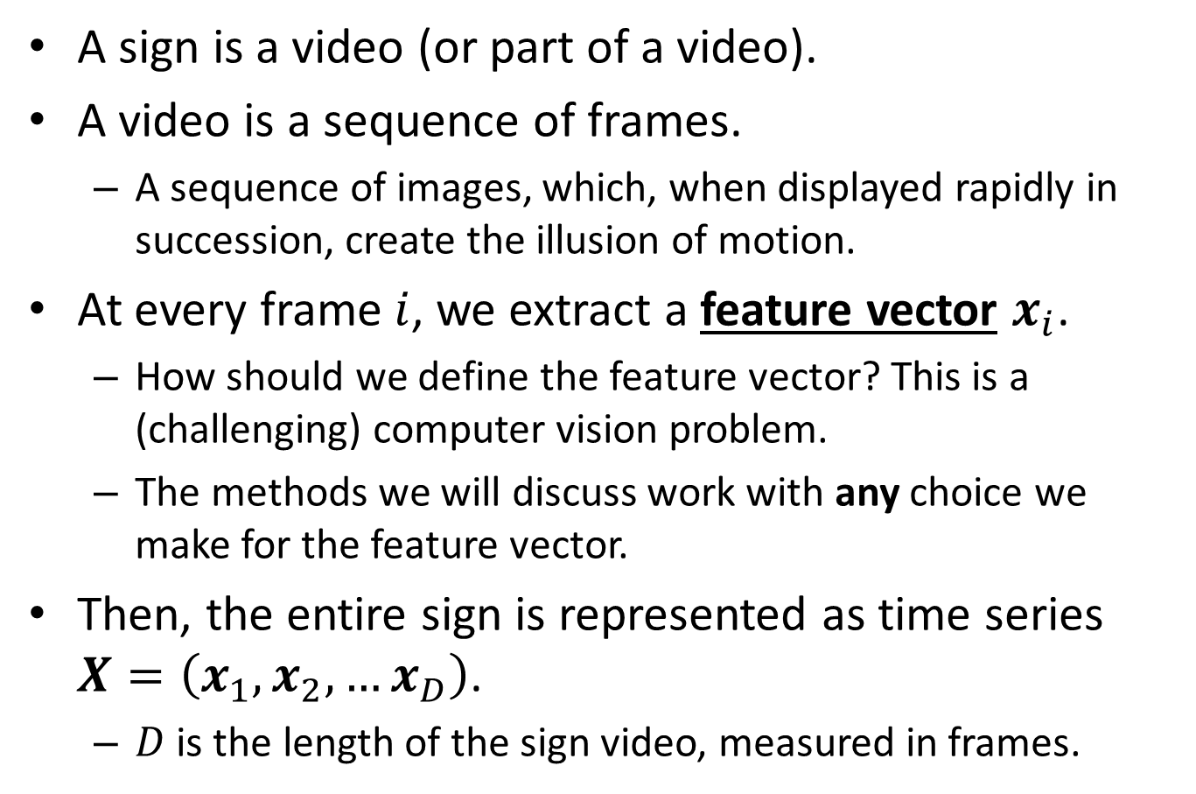
Representing Signs as Time Series
A sign is a video (or part of a video).
A video is a sequence of frames.
A sequence of images, which, when displayed rapidly in succession, create the illusion of motion.
At every frame $i$, we extract a feature vector $x_{i}$.
How should we define the feature vector? This is a (challenging) computer vision problem.
The methods we will discuss work with any choice we make for the feature vector.
Then, the entire sign is represented as time series $X=\left(x_{1},x_{2},…x_{D}\right)$.
$D$ is the length of the sign video, measured in frames.

Slide 10
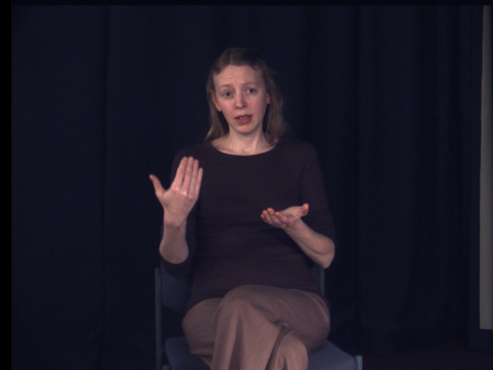
Feature Vectors
We choose a simple approach: the feature vector at each frame is the (x, y) pixel location of the right hand at that frame.

Slide 11
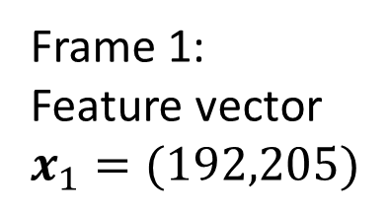
Feature Vectors
We choose a simple approach: the feature vector at each frame is the (x, y) pixel location of the right hand at that frame.
Frame 1:
Feature vector
$x_{1}=(192,205)$

Slide 12
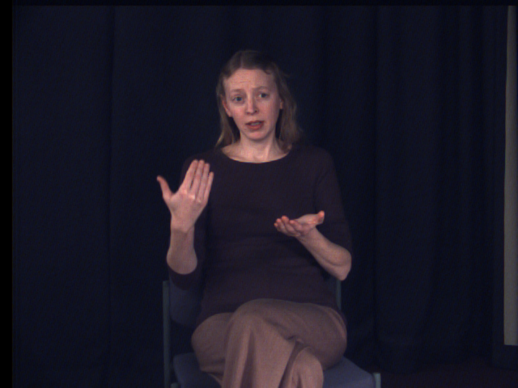
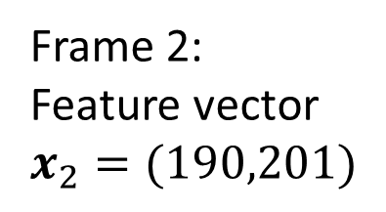
Feature Vectors
We choose a simple approach: the feature vector at each frame is the (x, y) pixel location of the right hand at that frame.
Frame 2:
Feature vector
$x_{2}=(190,201)$

Slide 13
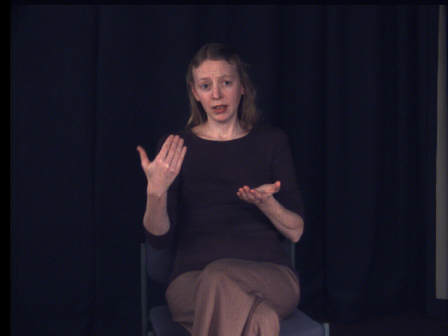
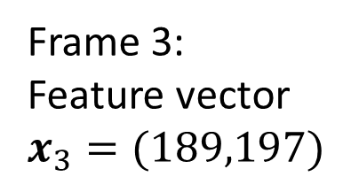
Feature Vectors
We choose a simple approach: the feature vector at each frame is the (x, y) pixel location of the right hand at that frame.
Frame 3:
Feature vector
$x_{3}=(189,197)$

Slide 14
Time Series for a Sign
Using the previous representation, for sign "AGAIN" we end up with this time series:
((192, 205),(190, 201),(190, 194),(191, 188),(194, 182),(205, 183), (211, 178),(217, 171),(225, 168),(232, 167),(233, 167),(238, 168), (241, 169),(243, 176),(254, 177),(256, 179),(258, 186),(269, 194), (271, 202),(274, 206),(276, 207),(277, 208)).
It is a sequence of 22 2D vectors.

Slide 15
Time Series Classification
Does this test sign mean "AGAIN", or "BICYCLE"?
We can use nearest-neighbor classification of the corresponding time series
Big question: what distance measure should we choose?

Slide 16



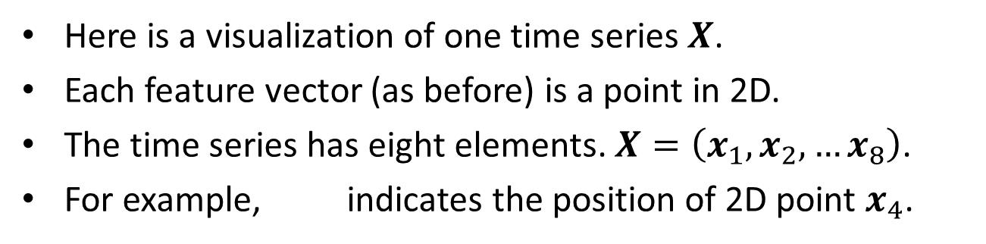






Visualizing a Time Series
$$x_{2}$$
$$x_{1}$$
$$x_{3}$$
$$x_{4}$$
$$x_{5}$$
$$x_{6}$$
$$x_{7}$$
$$x_{8}$$
Here is a visualization of one time series $X$.
Each feature vector (as before) is a point in 2D.
The time series has eight elements. $X=\left(x_{1},x_{2},…x_{8}\right)$.
For example, indicates the position of 2D point $x_{4}$.
$$x_{4}$$

Slide 17




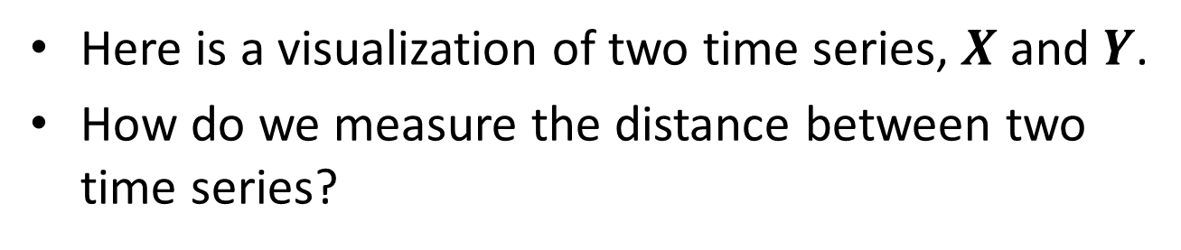





Comparing Time Series
$$x_{2}$$
$$y_{2}$$
$$y_{3}$$
$$x_{1}$$
$$x_{3}$$
$$y_{4}$$
$$y_{1}$$
$$y_{5}$$
$$x_{4}$$
$$y_{6}$$
$$x_{5}$$
$$y_{7}$$
$$y_{8}$$
$$y_{9}$$
$$x_{6}$$
$$x_{7}$$
$$x_{8}$$
Here is a visualization of two time series, $X$ and $Y$.
How do we measure the distance between two time series?

Slide 18
Comparing Time Series
$$x_{2}$$
$$y_{2}$$
$$y_{3}$$
$$x_{1}$$
$$x_{3}$$
$$y_{4}$$
$$y_{1}$$
$$y_{5}$$
$$x_{4}$$
$$y_{6}$$
$$x_{5}$$
$$y_{7}$$
$$y_{8}$$
$$y_{9}$$
$$x_{6}$$
$$x_{7}$$
$$x_{8}$$
We could possibly use the Euclidean distance.
The first time series is a 16-dimensional vector.
The second time series is an 18-dimensional vector.
However, there are issues…

Slide 19
Problems with the Euclidean Distance
$$x_{2}$$
$$y_{2}$$
$$y_{3}$$
$$x_{1}$$
$$x_{3}$$
$$y_{4}$$
$$y_{1}$$
$$y_{5}$$
$$x_{4}$$
$$y_{6}$$
$$x_{5}$$
$$y_{7}$$
$$y_{8}$$
$$y_{9}$$
$$x_{6}$$
$$x_{7}$$
$$x_{8}$$
The two vectors have different numbers of dimensions.
We could fix that by "stretching" the first time series to also have 9 elements.

Slide 20








Problems with the Euclidean Distance
$$x_{2}$$
$$y_{2}$$
$$y_{3}$$
$$x_{1}$$
$$x_{3}$$
$$y_{4}$$
$$y_{1}$$
$$x_{4}$$
$$y_{5}$$
$$x_{5}$$
$$y_{6}$$
$$x_{6}$$
$$y_{7}$$
$$y_{8}$$
$$y_{9}$$
$$x_{7}$$
$$x_{8}$$
$$x_{9}$$
Here, the time series on the left has been converted to have nine elements, using interpolation.
We will not explore that option any further, because…

Slide 21
Problems with the Euclidean Distance
$$x_{2}$$
$$y_{2}$$
$$y_{3}$$
$$x_{1}$$
$$x_{3}$$
$$y_{4}$$
$$y_{1}$$
$$y_{5}$$
$$x_{4}$$
$$y_{6}$$
$$x_{5}$$
$$y_{7}$$
$$y_{8}$$
$$y_{9}$$
$$x_{6}$$
$$x_{7}$$
$$x_{8}$$
Bigger problem: the two time series correspond to a similar pattern being performed with variable speed.
The first five elements of the first time series visually match the first seven elements of the second time series.

Slide 22
Problems with the Euclidean Distance
$$x_{2}$$
$$y_{2}$$
$$y_{3}$$
$$x_{1}$$
$$x_{3}$$
$$y_{4}$$
$$y_{1}$$
$$y_{5}$$
$$x_{4}$$
$$y_{6}$$
$$x_{5}$$
$$y_{7}$$
$$y_{8}$$
$$y_{9}$$
$$x_{6}$$
$$x_{7}$$
$$x_{8}$$
So, the first time series had a faster speed than the second time series initially.
It took 5 time ticks for the first time series, and seven time ticks for the second time series, to move through approximately the same trajectory.

Slide 23
Problems with the Euclidean Distance
$$x_{2}$$
$$y_{2}$$
$$y_{3}$$
$$x_{1}$$
$$x_{3}$$
$$y_{4}$$
$$y_{1}$$
$$y_{5}$$
$$x_{4}$$
$$y_{6}$$
$$x_{5}$$
$$y_{7}$$
$$y_{8}$$
$$y_{9}$$
$$x_{6}$$
$$x_{7}$$
$$x_{8}$$
Similarly, the last four elements of the first time series visually match the last three elements of the second time series.
So, the first time series had a faster speed than the second time series in the last part.
4 time ticks for the first time series, 3 time ticks for the second one.

Slide 24
Time Series Alignment
$$x_{2}$$
$$y_{2}$$
$$y_{3}$$
$$x_{1}$$
$$x_{3}$$
$$y_{4}$$
$$y_{1}$$
$$y_{5}$$
$$x_{4}$$
$$y_{6}$$
$$x_{5}$$
$$y_{7}$$
$$y_{8}$$
$$y_{9}$$
$$x_{6}$$
$$x_{7}$$
$$x_{8}$$
An alignment is a correspondence between elements of two time series.
To reliably measure the similarity between two time series, we need to figure out, for each element of the first time series, which elements of the second time series it corresponds to.

Slide 25
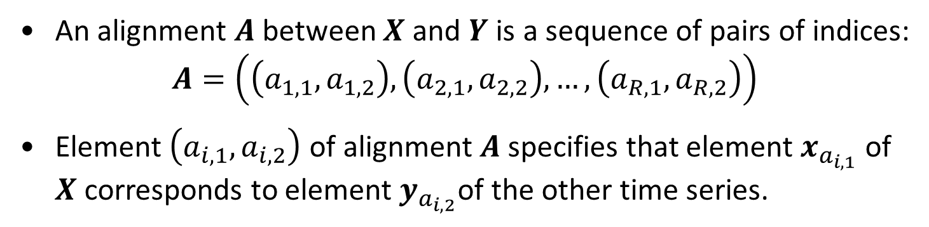
Time Series Alignment
$$x_{2}$$
$$y_{2}$$
$$y_{3}$$
$$x_{1}$$
$$x_{3}$$
$$y_{4}$$
$$y_{1}$$
$$y_{5}$$
$$x_{4}$$
$$y_{6}$$
$$x_{5}$$
$$y_{7}$$
$$y_{8}$$
$$y_{9}$$
$$x_{6}$$
$$x_{7}$$
$$x_{8}$$
An alignment $A$ between $X$ and $Y$ is a sequence of pairs of indices: $A=\left(\left(a_{1,1},a_{1,2}\right),\left(a_{2,1},a_{2,2}\right),…,\left(a_{R,1},a_{R,2}\right)\right)$
Element $\left(a_{i,1},a_{i,2}\right)$ of alignment $A$specifies that element $x_{a_{i,1}}$ of $X$corresponds to element $y_{a_{i,2}}$of the other time series.

Slide 26
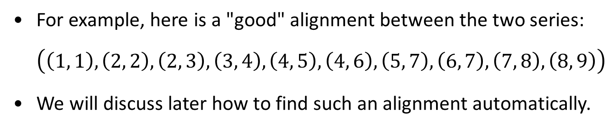
Time Series Alignment
$$x_{2}$$
$$y_{2}$$
$$y_{3}$$
$$x_{1}$$
$$x_{3}$$
$$y_{4}$$
$$y_{1}$$
$$y_{5}$$
$$x_{4}$$
$$y_{6}$$
$$x_{5}$$
$$y_{7}$$
$$y_{8}$$
$$y_{9}$$
$$x_{6}$$
$$x_{7}$$
$$x_{8}$$
For example, here is a "good" alignment between the two series: $\left(\left(1, 1\right), \left(2, 2\right), \left(2, 3\right), \left(3, 4\right), \left(4, 5\right), \left(4, 6\right), \left(5, 7\right), \left(6, 7\right), \left(7, 8\right), \left(8, 9\right)\right)$
We will discuss later how to find such an alignment automatically.

Slide 27
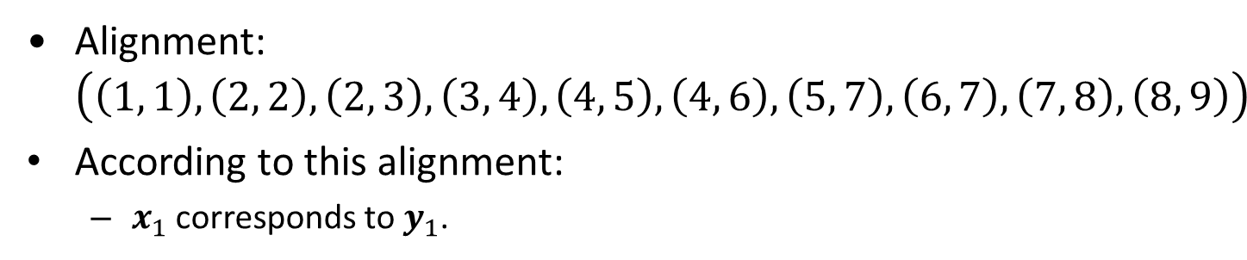
Time Series Alignment
$$x_{2}$$
$$y_{2}$$
$$y_{3}$$
$$x_{1}$$
$$x_{3}$$
$$y_{4}$$
$$y_{1}$$
$$y_{5}$$
$$x_{4}$$
$$y_{6}$$
$$x_{5}$$
$$y_{7}$$
$$y_{8}$$
$$y_{9}$$
$$x_{6}$$
$$x_{7}$$
$$x_{8}$$
Alignment: $\left(\left(1, 1\right), \left(2, 2\right), \left(2, 3\right), \left(3, 4\right), \left(4, 5\right), \left(4, 6\right), \left(5, 7\right), \left(6, 7\right), \left(7, 8\right), \left(8, 9\right)\right)$
According to this alignment:
$x_{1}$ corresponds to $y_{1}$.

Slide 28
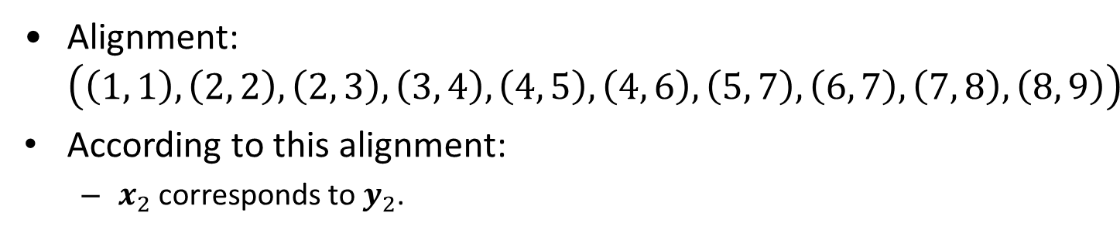
Time Series Alignment
$$x_{2}$$
$$y_{2}$$
$$y_{3}$$
$$x_{1}$$
$$x_{3}$$
$$y_{4}$$
$$y_{1}$$
$$y_{5}$$
$$x_{4}$$
$$y_{6}$$
$$x_{5}$$
$$y_{7}$$
$$y_{8}$$
$$y_{9}$$
$$x_{6}$$
$$x_{7}$$
$$x_{8}$$
Alignment: $\left(\left(1, 1\right), \left(2, 2\right), \left(2, 3\right), \left(3, 4\right), \left(4, 5\right), \left(4, 6\right), \left(5, 7\right), \left(6, 7\right), \left(7, 8\right), \left(8, 9\right)\right)$
According to this alignment:
$x_{2}$ corresponds to $y_{2}$.

Slide 29
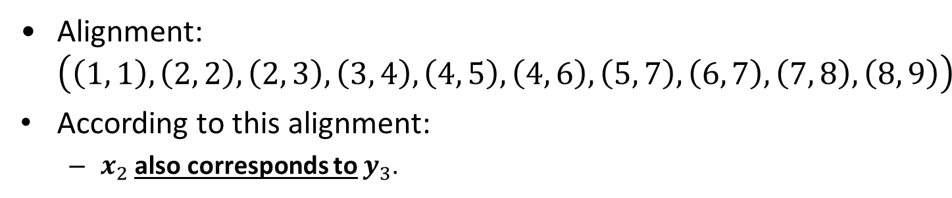
Time Series Alignment
$$x_{2}$$
$$y_{2}$$
$$y_{3}$$
$$x_{1}$$
$$x_{3}$$
$$y_{4}$$
$$y_{1}$$
$$y_{5}$$
$$x_{4}$$
$$y_{6}$$
$$x_{5}$$
$$y_{7}$$
$$y_{8}$$
$$y_{9}$$
$$x_{6}$$
$$x_{7}$$
$$x_{8}$$
Alignment: $\left(\left(1, 1\right), \left(2, 2\right), \left(2, 3\right), \left(3, 4\right), \left(4, 5\right), \left(4, 6\right), \left(5, 7\right), \left(6, 7\right), \left(7, 8\right), \left(8, 9\right)\right)$
According to this alignment:
$x_{2}$ also corresponds to $y_{3}$.

Slide 30
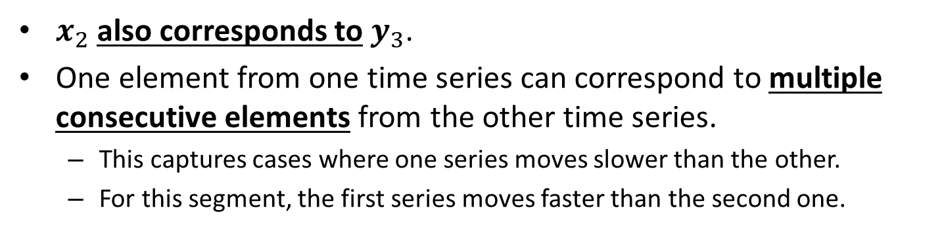
Time Series Alignment
$$x_{2}$$
$$y_{2}$$
$$y_{3}$$
$$x_{1}$$
$$x_{3}$$
$$y_{4}$$
$$y_{1}$$
$$y_{5}$$
$$x_{4}$$
$$y_{6}$$
$$x_{5}$$
$$y_{7}$$
$$y_{8}$$
$$y_{9}$$
$$x_{6}$$
$$x_{7}$$
$$x_{8}$$
$x_{2}$ also corresponds to $y_{3}$.
One element from one time series can correspond to multiple consecutive elements from the other time series.
This captures cases where one series moves slower than the other.
For this segment, the first series moves faster than the second one.

Slide 31
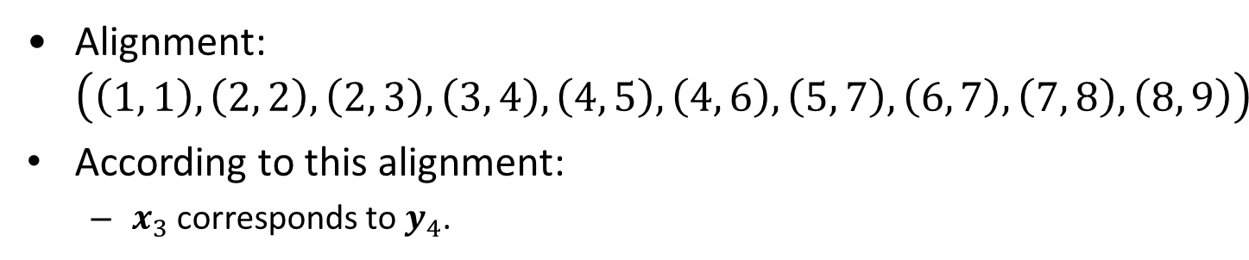
Time Series Alignment
$$x_{2}$$
$$y_{2}$$
$$y_{3}$$
$$x_{1}$$
$$x_{3}$$
$$y_{4}$$
$$y_{1}$$
$$y_{5}$$
$$x_{4}$$
$$y_{6}$$
$$x_{5}$$
$$y_{7}$$
$$y_{8}$$
$$y_{9}$$
$$x_{6}$$
$$x_{7}$$
$$x_{8}$$
Alignment: $\left(\left(1, 1\right), \left(2, 2\right), \left(2, 3\right), \left(3, 4\right), \left(4, 5\right), \left(4, 6\right), \left(5, 7\right), \left(6, 7\right), \left(7, 8\right), \left(8, 9\right)\right)$
According to this alignment:
$x_{3}$ corresponds to $y_{4}$.

Slide 32
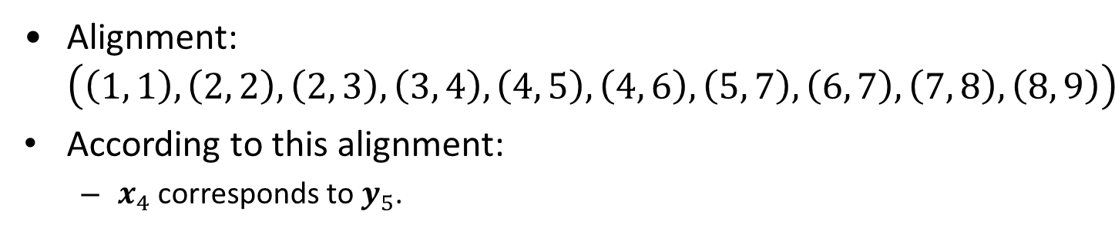
Time Series Alignment
$$x_{2}$$
$$y_{2}$$
$$y_{3}$$
$$x_{1}$$
$$x_{3}$$
$$y_{4}$$
$$y_{1}$$
$$y_{5}$$
$$x_{4}$$
$$y_{6}$$
$$x_{5}$$
$$y_{7}$$
$$y_{8}$$
$$y_{9}$$
$$x_{6}$$
$$x_{7}$$
$$x_{8}$$
Alignment: $\left(\left(1, 1\right), \left(2, 2\right), \left(2, 3\right), \left(3, 4\right), \left(4, 5\right), \left(4, 6\right), \left(5, 7\right), \left(6, 7\right), \left(7, 8\right), \left(8, 9\right)\right)$
According to this alignment:
$x_{4}$ corresponds to $y_{5}$.

Slide 33
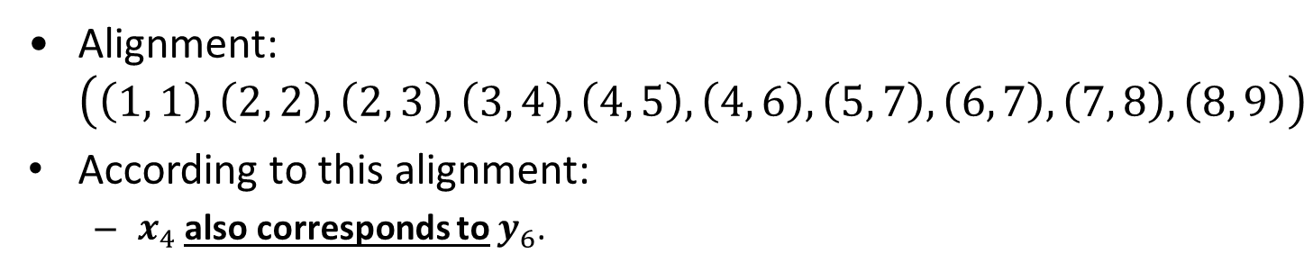
Time Series Alignment
$$x_{2}$$
$$y_{2}$$
$$y_{3}$$
$$x_{1}$$
$$x_{3}$$
$$y_{4}$$
$$y_{1}$$
$$y_{5}$$
$$x_{4}$$
$$y_{6}$$
$$x_{5}$$
$$y_{7}$$
$$y_{8}$$
$$y_{9}$$
$$x_{6}$$
$$x_{7}$$
$$x_{8}$$
Alignment: $\left(\left(1, 1\right), \left(2, 2\right), \left(2, 3\right), \left(3, 4\right), \left(4, 5\right), \left(4, 6\right), \left(5, 7\right), \left(6, 7\right), \left(7, 8\right), \left(8, 9\right)\right)$
According to this alignment:
$x_{4}$ also corresponds to $y_{6}$.

Slide 34
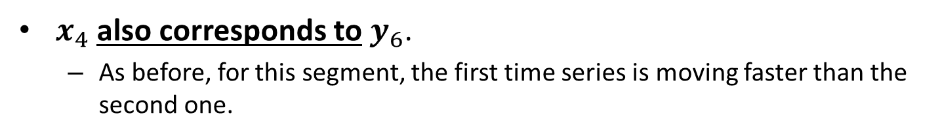
Time Series Alignment
$$x_{2}$$
$$y_{2}$$
$$y_{3}$$
$$x_{1}$$
$$x_{3}$$
$$y_{4}$$
$$y_{1}$$
$$y_{5}$$
$$x_{4}$$
$$y_{6}$$
$$x_{5}$$
$$y_{7}$$
$$y_{8}$$
$$y_{9}$$
$$x_{6}$$
$$x_{7}$$
$$x_{8}$$
$x_{4}$ also corresponds to $y_{6}$.
As before, for this segment, the first time series is moving faster than the second one.

Slide 35
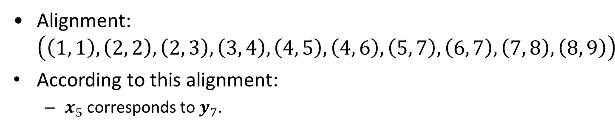
Time Series Alignment
$$x_{2}$$
$$y_{2}$$
$$y_{3}$$
$$x_{1}$$
$$x_{3}$$
$$y_{4}$$
$$y_{1}$$
$$y_{5}$$
$$x_{4}$$
$$y_{6}$$
$$x_{5}$$
$$y_{7}$$
$$y_{8}$$
$$y_{9}$$
$$x_{6}$$
$$x_{7}$$
$$x_{8}$$
Alignment: $\left(\left(1, 1\right), \left(2, 2\right), \left(2, 3\right), \left(3, 4\right), \left(4, 5\right), \left(4, 6\right), \left(5, 7\right), \left(6, 7\right), \left(7, 8\right), \left(8, 9\right)\right)$
According to this alignment:
$x_{5}$ corresponds to $y_{7}$.

Slide 36
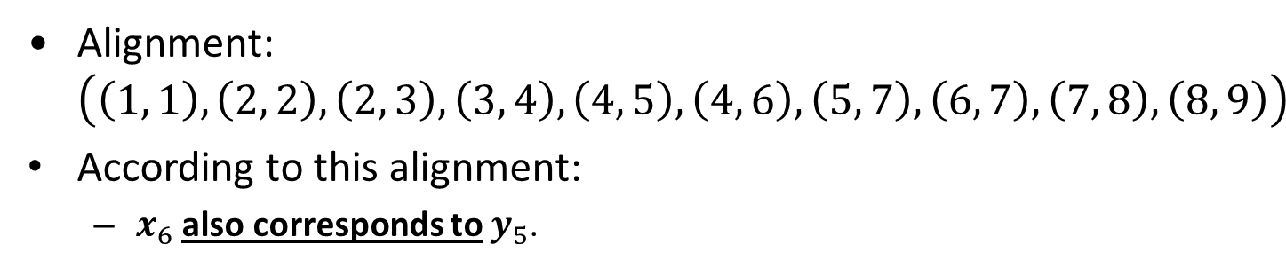
Time Series Alignment
$$x_{2}$$
$$y_{2}$$
$$y_{3}$$
$$x_{1}$$
$$x_{3}$$
$$y_{4}$$
$$y_{1}$$
$$y_{5}$$
$$x_{4}$$
$$y_{6}$$
$$x_{5}$$
$$y_{7}$$
$$y_{8}$$
$$y_{9}$$
$$x_{6}$$
$$x_{7}$$
$$x_{8}$$
Alignment: $\left(\left(1, 1\right), \left(2, 2\right), \left(2, 3\right), \left(3, 4\right), \left(4, 5\right), \left(4, 6\right), \left(5, 7\right), \left(6, 7\right), \left(7, 8\right), \left(8, 9\right)\right)$
According to this alignment:
$x_{6}$ also corresponds to $y_{5}$.

Slide 37
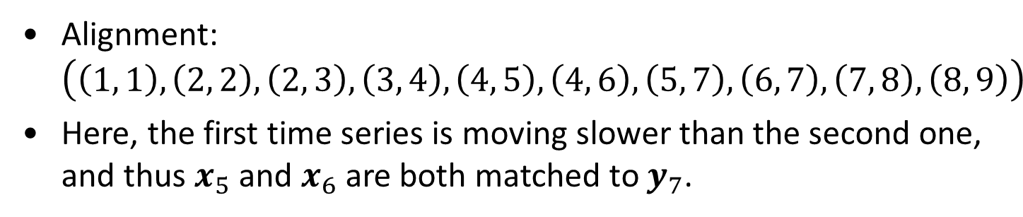
Time Series Alignment
$$x_{2}$$
$$y_{2}$$
$$y_{3}$$
$$x_{1}$$
$$x_{3}$$
$$y_{4}$$
$$y_{1}$$
$$y_{5}$$
$$x_{4}$$
$$y_{6}$$
$$x_{5}$$
$$y_{7}$$
$$y_{8}$$
$$y_{9}$$
$$x_{6}$$
$$x_{7}$$
$$x_{8}$$
Alignment: $\left(\left(1, 1\right), \left(2, 2\right), \left(2, 3\right), \left(3, 4\right), \left(4, 5\right), \left(4, 6\right), \left(5, 7\right), \left(6, 7\right), \left(7, 8\right), \left(8, 9\right)\right)$
Here, the first time series is moving slower than the second one, and thus $x_{5}$and $x_{6}$are both matched to $y_{7}$.

Slide 38
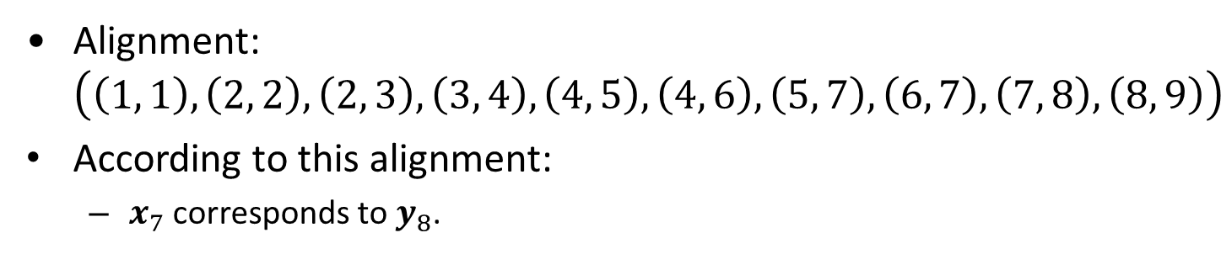
Time Series Alignment
$$x_{2}$$
$$y_{2}$$
$$y_{3}$$
$$x_{1}$$
$$x_{3}$$
$$y_{4}$$
$$y_{1}$$
$$y_{5}$$
$$x_{4}$$
$$y_{6}$$
$$x_{5}$$
$$y_{7}$$
$$y_{8}$$
$$y_{9}$$
$$x_{6}$$
$$x_{7}$$
$$x_{8}$$
Alignment: $\left(\left(1, 1\right), \left(2, 2\right), \left(2, 3\right), \left(3, 4\right), \left(4, 5\right), \left(4, 6\right), \left(5, 7\right), \left(6, 7\right), \left(7, 8\right), \left(8, 9\right)\right)$
According to this alignment:
$x_{7}$ corresponds to $y_{8}$.

Slide 39
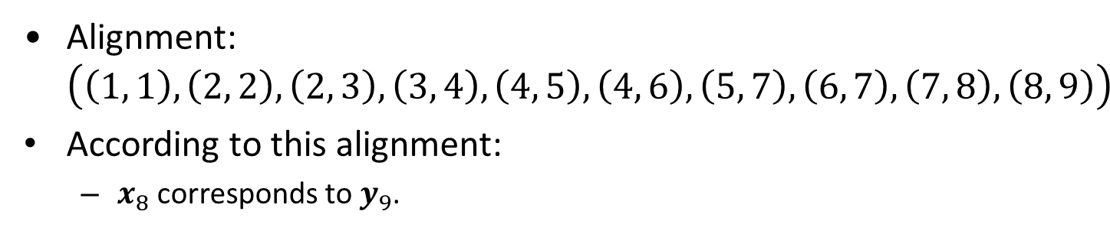
Time Series Alignment
$$x_{2}$$
$$y_{2}$$
$$y_{3}$$
$$x_{1}$$
$$x_{3}$$
$$y_{4}$$
$$y_{1}$$
$$y_{5}$$
$$x_{4}$$
$$y_{6}$$
$$x_{5}$$
$$y_{7}$$
$$y_{8}$$
$$y_{9}$$
$$x_{6}$$
$$x_{7}$$
$$x_{8}$$
Alignment: $\left(\left(1, 1\right), \left(2, 2\right), \left(2, 3\right), \left(3, 4\right), \left(4, 5\right), \left(4, 6\right), \left(5, 7\right), \left(6, 7\right), \left(7, 8\right), \left(8, 9\right)\right)$
According to this alignment:
$x_{8}$ corresponds to $y_{9}$.

Slide 40

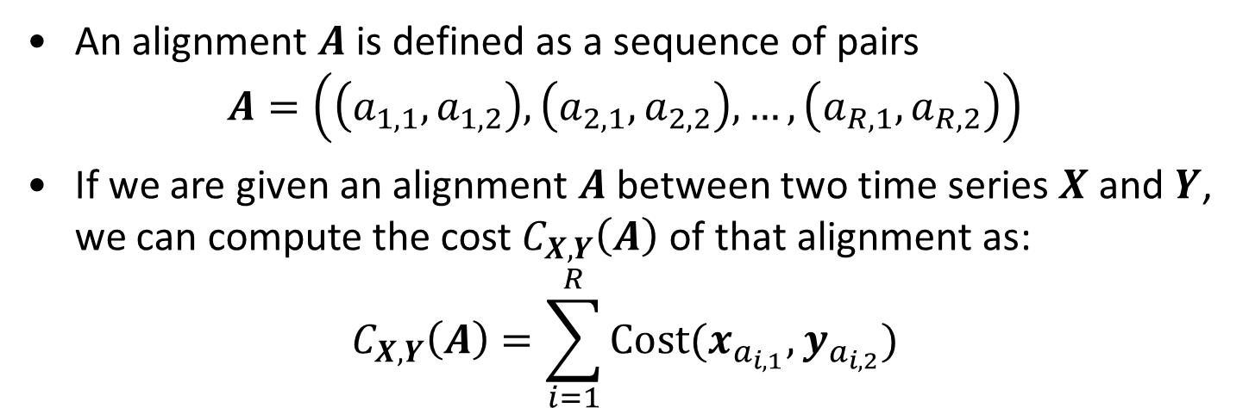
The Cost of an Alignment
$$x_{2}$$
$$y_{2}$$
$$y_{3}$$
$$x_{1}$$
$$x_{3}$$
$$y_{4}$$
$$y_{1}$$
$$y_{5}$$
$$x_{4}$$
$$y_{6}$$
$$x_{5}$$
$$x_{8}$$
$$y_{7}$$
$$y_{8}$$
$$y_{9}$$
$$x_{6}$$
$$x_{7}$$
An alignment $A$is defined as a sequence of pairs $A=\left(\left(a_{1,1},a_{1,2}\right),\left(a_{2,1},a_{2,2}\right),…,\left(a_{R,1},a_{R,2}\right)\right)$
If we are given an alignment $A$ between two time series $X$ and $Y$, we can compute the cost $C_{X,Y}\left(A\right)$ of that alignment as:
$$C_{X,Y}\left(A\right)=\sum_{i=1}^{R}{Cost(x_{a_{i,1}},y_{a_{i,2}})}$$

Slide 41
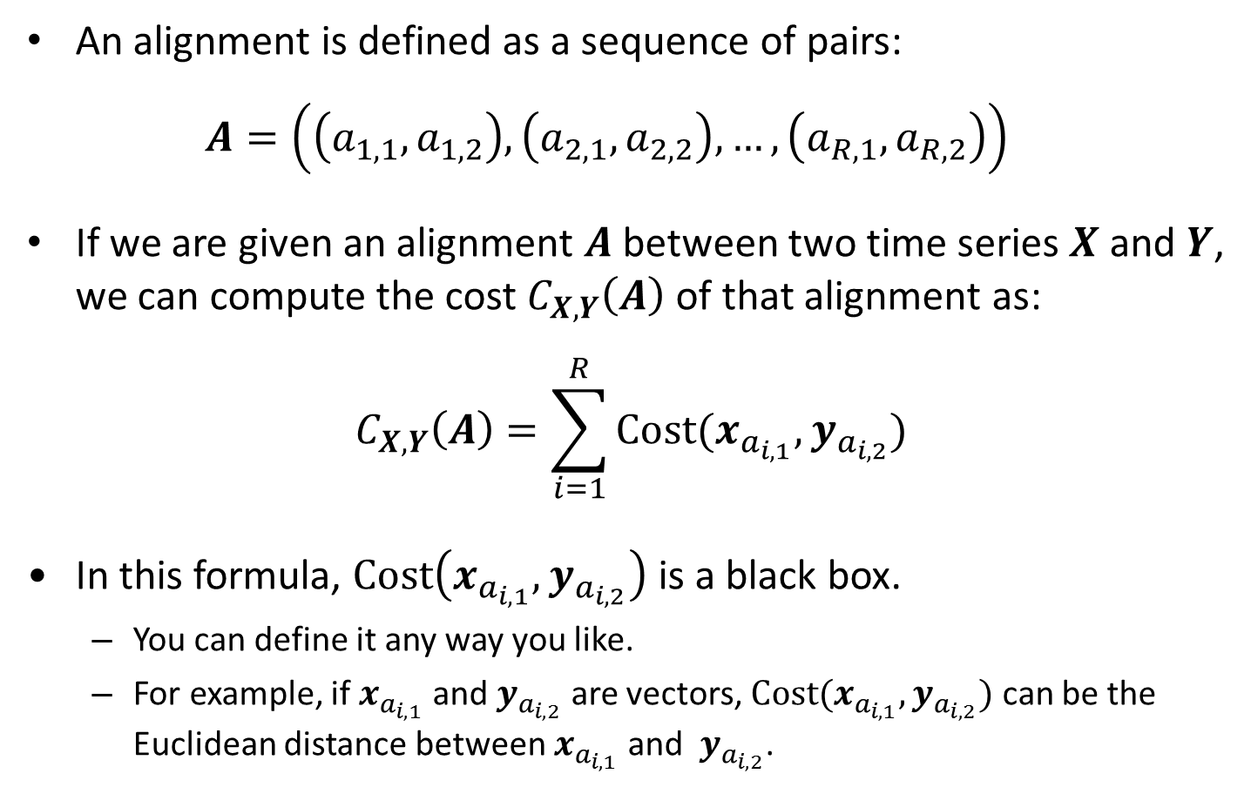
The Cost of an Alignment
An alignment is defined as a sequence of pairs: $A=\left(\left(a_{1,1},a_{1,2}\right),\left(a_{2,1},a_{2,2}\right),…,\left(a_{R,1},a_{R,2}\right)\right)$
If we are given an alignment $A$ between two time series $X$ and $Y$, we can compute the cost $C_{X,Y}\left(A\right)$of that alignment as:
$$C_{X,Y}\left(A\right)=\sum_{i=1}^{R}{Cost(x_{a_{i,1}},y_{a_{i,2}})}$$
In this formula, $Cost\left(x_{a_{i,1}},y_{a_{i,2}}\right)$ is a black box.
You can define it any way you like.
For example, if $x_{a_{i,1}}$ and $y_{a_{i,2}}$ are vectors, $Cost(x_{a_{i,1}},y_{a_{i,2}})$ can be the Euclidean distance between $x_{a_{i,1}}$ and $y_{a_{i,2}}$.

Slide 42
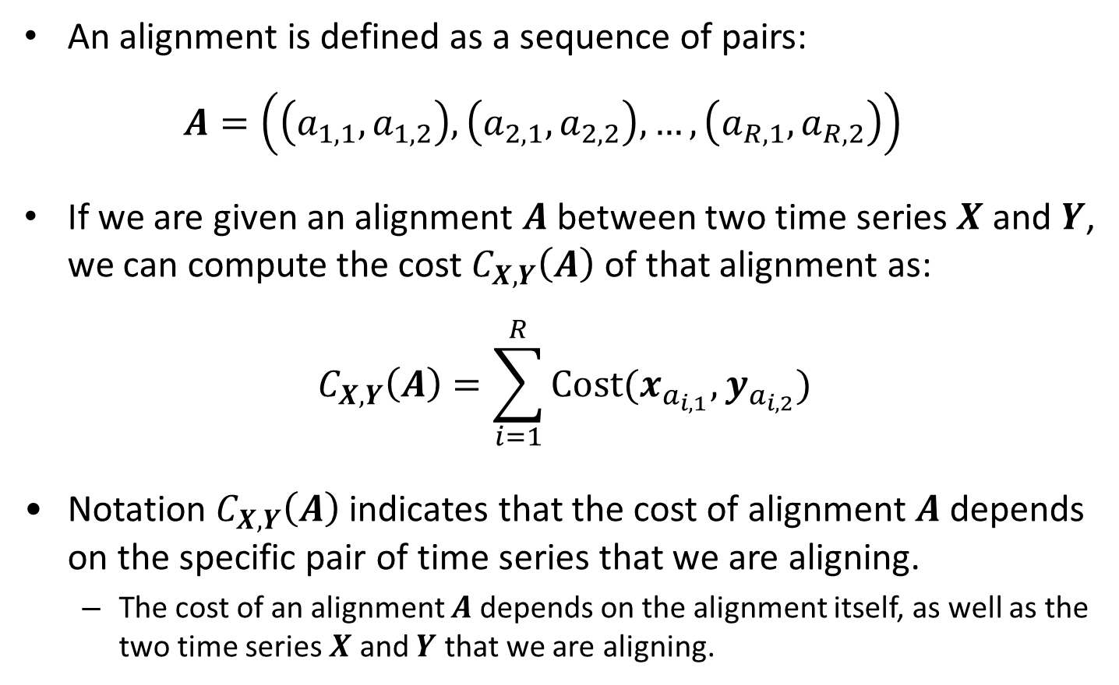
The Cost of an Alignment
An alignment is defined as a sequence of pairs: $A=\left(\left(a_{1,1},a_{1,2}\right),\left(a_{2,1},a_{2,2}\right),…,\left(a_{R,1},a_{R,2}\right)\right)$
If we are given an alignment $A$ between two time series $X$ and $Y$, we can compute the cost $C_{X,Y}\left(A\right)$of that alignment as:
$$C_{X,Y}\left(A\right)=\sum_{i=1}^{R}{Cost(x_{a_{i,1}},y_{a_{i,2}})}$$
Notation $C_{X,Y}\left(A\right)$ indicates that the cost of alignment $A$ depends on the specific pair of time series that we are aligning.
The cost of an alignment $A$depends on the alignment itself, as well as the two time series $X$ and $Y$ that we are aligning.

Slide 43
Rules of Alignment
$$x_{2}$$
$$y_{2}$$
$$y_{3}$$
$$x_{1}$$
$$x_{3}$$
$$y_{4}$$
$$y_{1}$$
$$y_{5}$$
$$x_{4}$$
$$y_{6}$$
$$x_{5}$$
$$x_{8}$$
$$y_{7}$$
$$y_{8}$$
$$y_{9}$$
$$x_{6}$$
$$x_{7}$$
We will require that legal alignments obey three rules:
Rule 1: Boundary Conditions.
Rule 2: Monotonicity.
Rule 3: Continuity
The next slides define these rules.

Slide 44
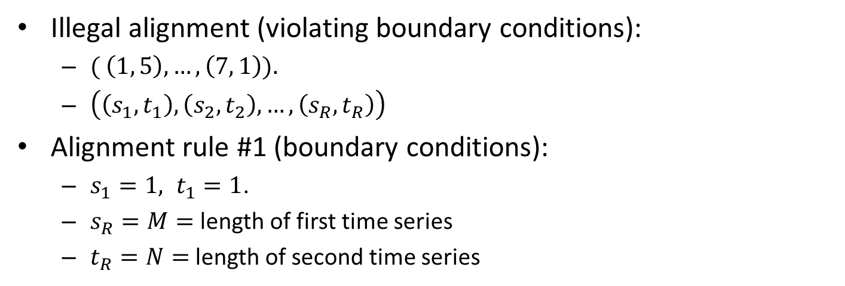
Rule 1: Boundary Conditions
$$x_{2}$$
$$y_{2}$$
$$y_{3}$$
$$x_{1}$$
$$x_{3}$$
$$y_{4}$$
$$y_{1}$$
$$y_{5}$$
$$x_{4}$$
$$y_{6}$$
$$x_{5}$$
$$x_{8}$$
$$y_{7}$$
$$y_{8}$$
$$y_{9}$$
$$x_{6}$$
$$x_{7}$$
Illegal alignment (violating boundary conditions):
$( \left(1, 5\right), …,\left(7, 1\right)).$
$\left(\left(s_{1},t_{1}\right),\left(s_{2},t_{2}\right),…,\left(s_{R},t_{R}\right)\right)$
Alignment rule #1 (boundary conditions):
$s_{1}=1, t_{1}=1$.
$s_{R}=M=$ length of first time series
$t_{R}=N=$ length of second time series
first elements match
last elements match

Slide 45
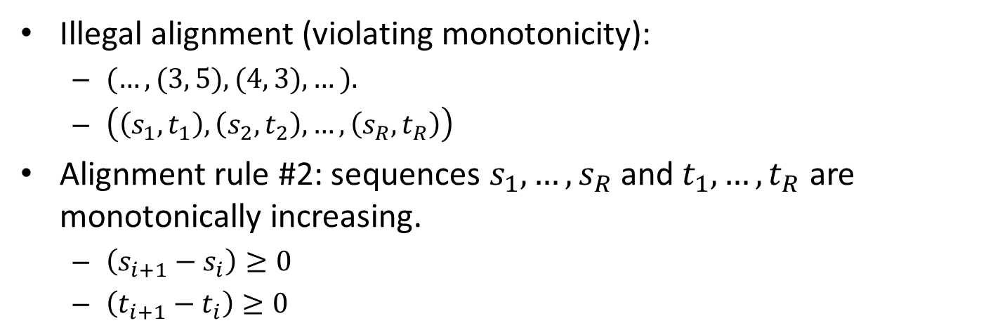
Rule 2: Monotonicity
$$x_{2}$$
$$y_{2}$$
$$y_{3}$$
$$x_{1}$$
$$x_{3}$$
$$y_{4}$$
$$y_{1}$$
$$y_{5}$$
$$x_{4}$$
$$y_{6}$$
$$x_{5}$$
$$x_{8}$$
$$y_{7}$$
$$y_{8}$$
$$y_{9}$$
$$x_{6}$$
$$x_{7}$$
Illegal alignment (violating monotonicity):
$(…, (3, 5), (4, 3), …).$
$\left(\left(s_{1},t_{1}\right),\left(s_{2},t_{2}\right),…,\left(s_{R},t_{R}\right)\right)$
Alignment rule #2: sequences $s_{1},…,s_{R}$ and $t_{1},…,t_{R}$ are monotonically increasing.
$\left(s_{i+1}−s_{i}\right)≥0$
$\left(t_{i+1}−t_{i}\right)≥0$
The alignment cannot go backwards.

Slide 46
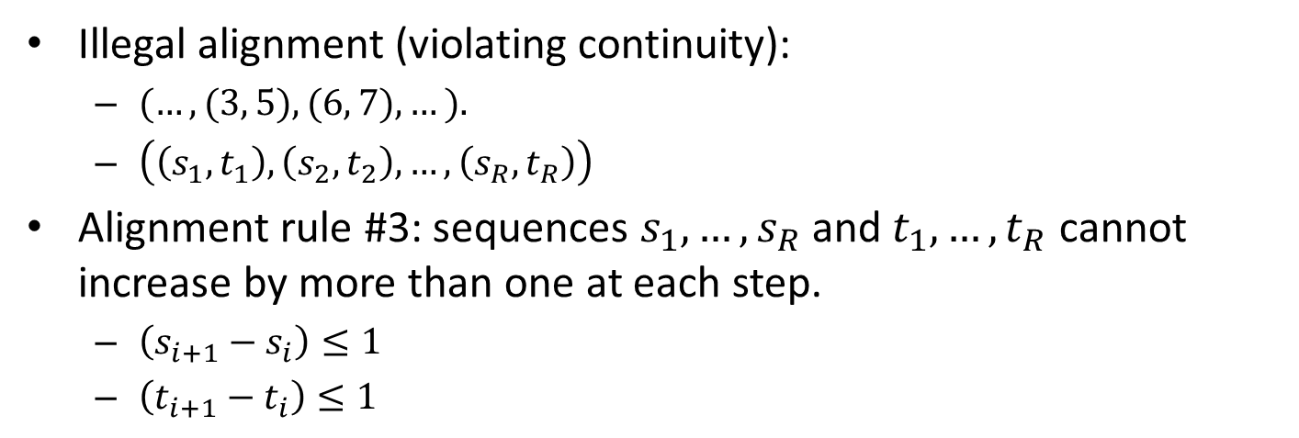
Rule 3: Continuity
$$x_{2}$$
$$y_{2}$$
$$y_{3}$$
$$x_{1}$$
$$x_{3}$$
$$y_{4}$$
$$y_{1}$$
$$y_{5}$$
$$x_{4}$$
$$y_{6}$$
$$x_{5}$$
$$x_{8}$$
$$y_{7}$$
$$y_{8}$$
$$y_{9}$$
$$x_{6}$$
$$x_{7}$$
Illegal alignment (violating continuity):
$(…, (3, 5), (6, 7), …).$
$\left(\left(s_{1},t_{1}\right),\left(s_{2},t_{2}\right),…,\left(s_{R},t_{R}\right)\right)$
Alignment rule #3: sequences $s_{1},…,s_{R}$ and $t_{1},…,t_{R}$ cannot increase by more than one at each step.
$\left(s_{i+1}−s_{i}\right)≤1$
$\left(t_{i+1}−t_{i}\right)≤1$
The alignment cannot skip elements.

Slide 47
Class work
$$x_{2}$$
$$y_{2}$$
$$y_{3}$$
$$x_{1}$$
$$x_{3}$$
$$y_{4}$$
$$y_{1}$$
$$y_{5}$$
$$x_{4}$$
$$y_{6}$$
$$x_{5}$$
$$x_{8}$$
$$y_{7}$$
$$y_{8}$$
$$y_{9}$$
$$x_{6}$$
$$x_{7}$$
Draw a valid alignment between the two sequences
What is the sequence of index pairs for this alignment?
Are there other valid alignments?

Slide 48
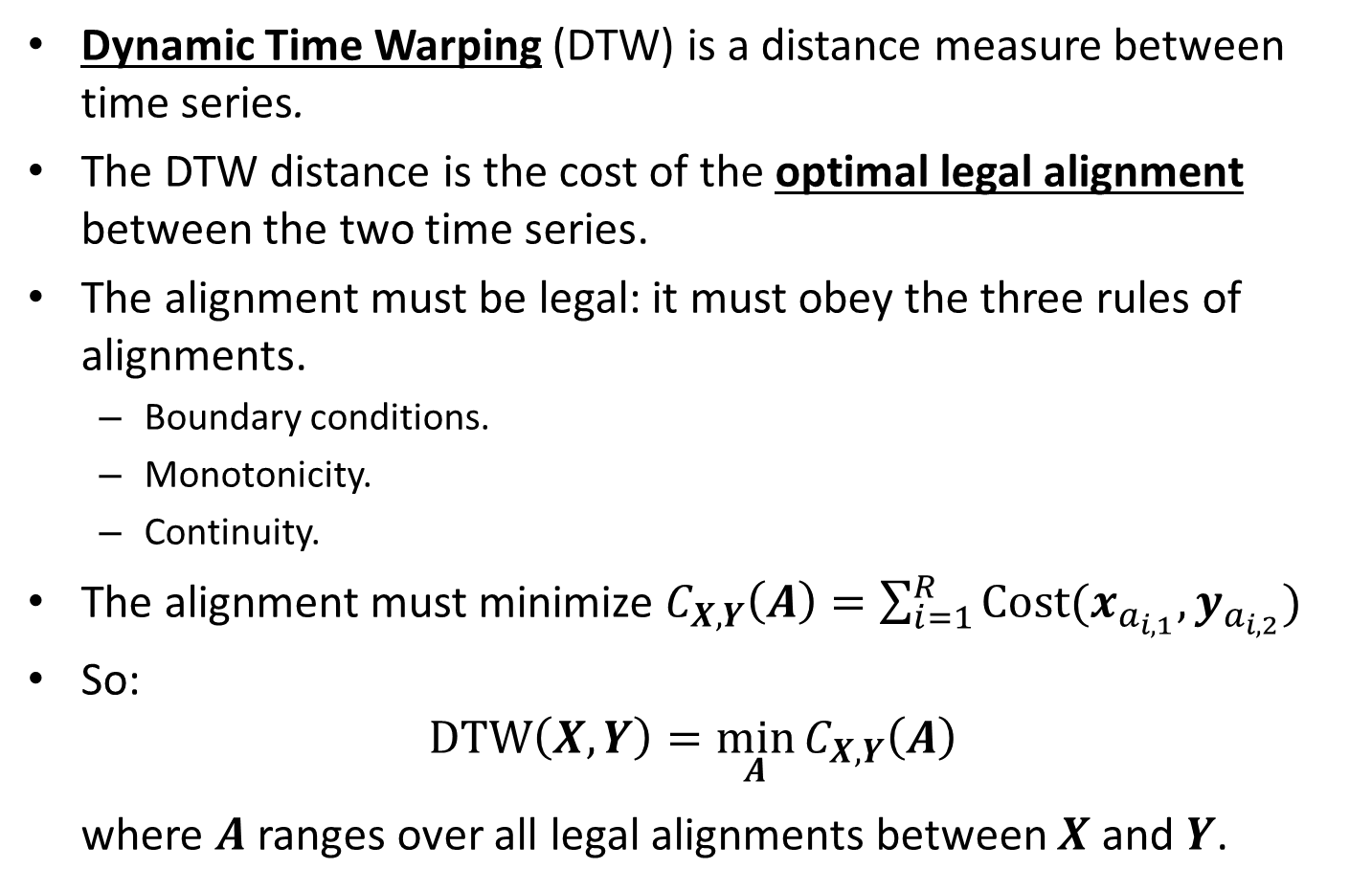
Dynamic Time Warping
Dynamic Time Warping (DTW) is a distance measure between time series.
The DTW distance is the cost of the optimal legal alignment between the two time series.
The alignment must be legal: it must obey the three rules of alignments.
Boundary conditions.
Monotonicity.
Continuity.
The alignment must minimize $C_{X,Y}\left(A\right)=\sum_{i=1}^{R}{Cost(x_{a_{i,1}},y_{a_{i,2}})}$
So:
$$DTW\left(X,Y\right)=\min_{A}{C_{X,Y}\left(A\right)}$$ where $A$ ranges over all legal alignments between $X$ and $Y$.

Slide 49
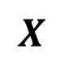
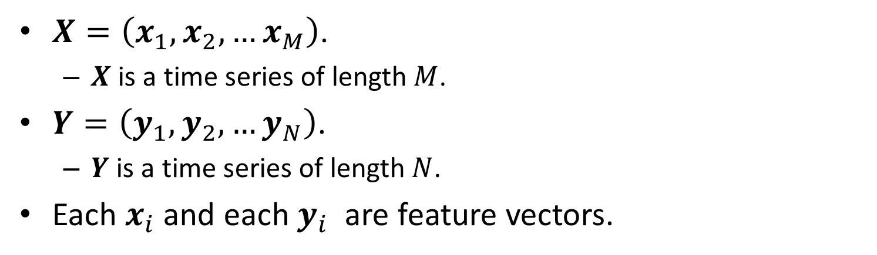
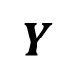
DTW: Input
$$x_{2}$$
$$y_{2}$$
$$y_{3}$$
$$x_{1}$$
$$x_{3}$$
$$y_{4}$$
$$y_{1}$$
$$y_{5}$$
$$x_{4}$$
$$y_{6}$$
$$x_{5}$$
$$x_{8}$$
$$y_{7}$$
$$y_{8}$$
$$y_{9}$$
$$x_{6}$$
$$x_{7}$$
$$X$$
$$Y$$
$X=\left(x_{1},x_{2},…x_{M}\right)$.
$X$ is a time series of length $M$.
$Y=\left(y_{1},y_{2},…y_{N}\right)$.
$Y$ is a time series of length $N$.
Each $x_{i}$ and each $y_{i}$ are feature vectors.

Slide 50

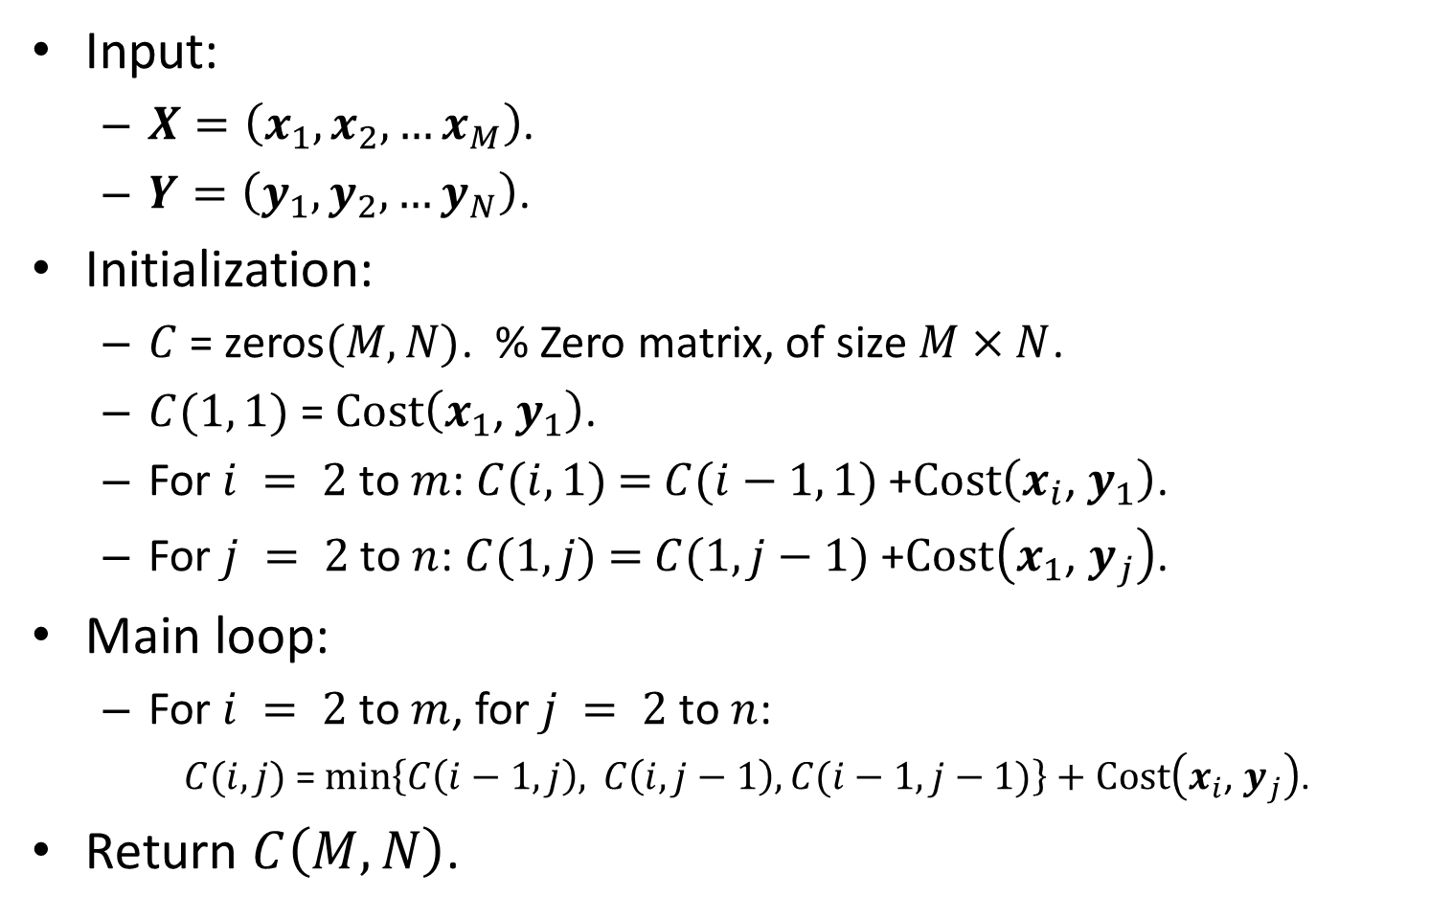
Computing DTW$(X, Y)$
Input:
$X=\left(x_{1},x_{2},…x_{M}\right)$.
$Y=\left(y_{1},y_{2},…y_{N}\right)\text{. }$
Initialization:
$C$ = zeros$(M, N)$. % Zero matrix, of size $M×N$.
$C(1, 1)$ = $Cost\left(x_{1}\text{, }y_{1}\right)$.
For $i = 2$ to $m$: $C(i, 1)$ $=$ $C(i−1, 1)$ +$Cost\left(x_{i}\text{, }y_{1}\right)$.
For $j = 2$ to $n$: $C(1, j)$ $=$ $C(1, j−1)$+$Cost\left(x_{1}\text{, }y_{j}\right)$.
Main loop:
For $i = 2$ to $m$, for $j = 2$ to $n$:
$C(i, j)$ = $min\left\{C\left(i−1, j\right), C\left(i, j−1\right),C(i−1, j−1)\right\}+Cost\left(x_{i}\text{, }y_{j}\right)$.
Return $C\left(M, N\right)$.

Slide 51
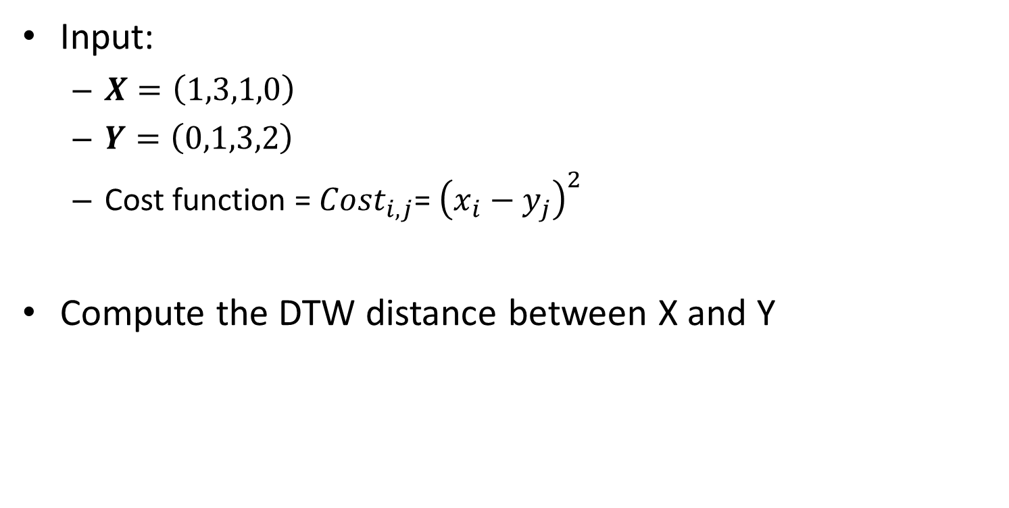
Example
Input:
$X=\left(1,3,1,0\right)$
$Y=\left(0,1,3,2\right)$
Cost function = ${Cost}_{i,j}$= ${\left(x_{i}−y_{j}\right)}^{2}$
Compute the DTW distance between X and Y

Slide 52
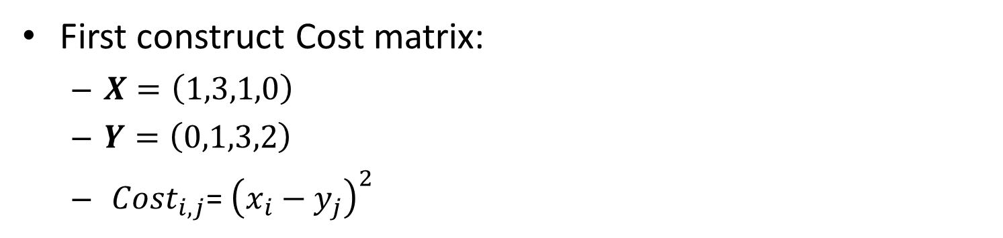
Example
First construct Cost matrix:
$X=\left(1,3,1,0\right)$
$Y=\left(0,1,3,2\right)$
${Cost}_{i,j}$= ${\left(x_{i}−y_{j}\right)}^{2}$
1
0
4
1
9
4
0
1
1
0
4
1
0
1
9
4

Slide 53
1
0
4
1
Example
9
4
0
1
1
0
4
1
0
1
9
4
Start filling in C matrix: $C(1, 1)$ = $Cost\left(x_{1}\text{, }y_{1}\right)$
1

Slide 54
1
0
4
1
Example
9
4
0
1
1
0
4
1
0
1
9
4
$C(i, 1)$ $=$ $C(i−1, 1)$ +$Cost\left(x_{i}\text{, }y_{1}\right)$
1
1
1
10
10
11
11

Slide 55
1
0
4
1
Example
9
4
0
1
1
0
4
1
0
1
9
4
$C(1, j)$ $=$ $C(1, j−1)$+$Cost\left(x_{1}\text{, }y_{j}\right)$
1
1
1
1
1
5
6
10
10
10
11
11
11
11
11
11

Slide 56
1
0
4
1
Example
9
4
0
1
1
0
4
1
0
1
9
4
$C(i, j)$ = $min\left\{C\left(i−1, j\right), C\left(i, j−1\right),C(i−1, j−1)\right\}+Cost\left(x_{i}\text{, }y_{j}\right)$
1
1
5
6
1
1
5
6
1
1
5
6
10
10
5
10
5
11
11
11
5
11
11
11
1
1
5
6
1
1
5
6
1
1
5
6
10
5
10
5
1
10
5
1
2
11
5
11
5
11
5
11
6
11
6
11
6

Slide 57
1
0
4
1
Example
9
4
0
1
1
0
4
1
0
1
9
4
$C(i, j)$ = $min\left\{C\left(i−1, j\right), C\left(i, j−1\right),C(i−1, j−1)\right\}+Cost\left(x_{i}\text{, }y_{j}\right)$
1
1
5
6
1
1
5
6
1
1
5
6
10
10
5
10
5
11
11
11
5
11
11
11
1
1
5
6
1
1
5
6
1
1
5
6
10
5
10
5
1
10
5
1
2
11
5
11
5
11
5
?
?
11
6
11
6
11
6
?
?

Slide 58
1
0
4
1
Example
9
4
0
1
1
0
4
1
0
1
9
4
$C(i, j)$ = $min\left\{C\left(i−1, j\right), C\left(i, j−1\right),C(i−1, j−1)\right\}+Cost\left(x_{i}\text{, }y_{j}\right)$
1
1
5
6
1
1
5
6
1
1
5
6
10
10
5
10
5
11
11
11
5
11
11
11
1
1
5
6
1
1
5
6
1
1
5
6
10
5
10
5
1
10
5
1
2
11
5
11
5
11
5
5
2
11
6
11
6
11
6
14
6

Slide 59
Example
$C(i, j)$ = $min\left\{C\left(i−1, j\right), C\left(i, j−1\right),C(i−1, j−1)\right\}+Cost\left(x_{i}\text{, }y_{j}\right)$
1
1
5
6
1
1
5
6
1
1
5
6
10
5
1
2
10
5
1
2
10
5
1
2
11
5
11
5
5
2
11
5
5
2
11
6
11
6
14
11
6
14
6
Compute the DTW distance between X and Y
Answer = 6

Slide 60
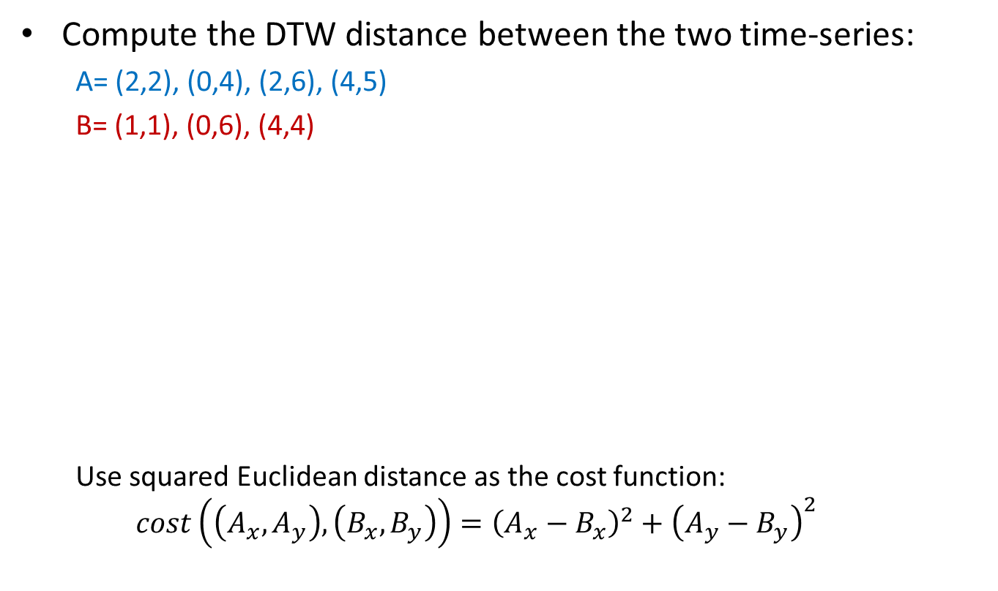
Class work
Compute the DTW distance between the two time-series:
A= (2,2), (0,4), (2,6), (4,5)
B= (1,1), (0,6), (4,4)
Use squared Euclidean distance as the cost function:
$$cost\left(\left(A_{x},A_{y}\right), \left(B_{x},B_{y}\right)\right)={\left(A_{x}−B_{x}\right)}^{2}+{\left(A_{y}−B_{y}\right)}^{2}$$
(0,4)
(0,6)
(2,2)
(1,1)
(2,6)
(4,5)
(4,4)

Slide 61
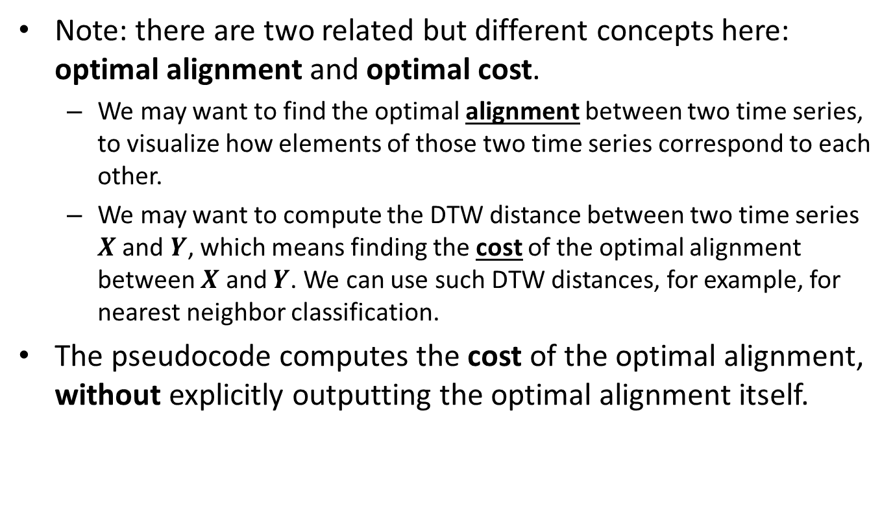
Cost vs. Alignment
Note: there are two related but different concepts here: optimal alignment and optimal cost.
We may want to find the optimal alignment between two time series, to visualize how elements of those two time series correspond to each other.
We may want to compute the DTW distance between two time series $X$ and $Y$, which means finding the cost of the optimal alignment between $X$ and $Y$. We can use such DTW distances, for example, for nearest neighbor classification.
The pseudocode computes the cost of the optimal alignment, without explicitly outputting the optimal alignment itself.

Slide 62
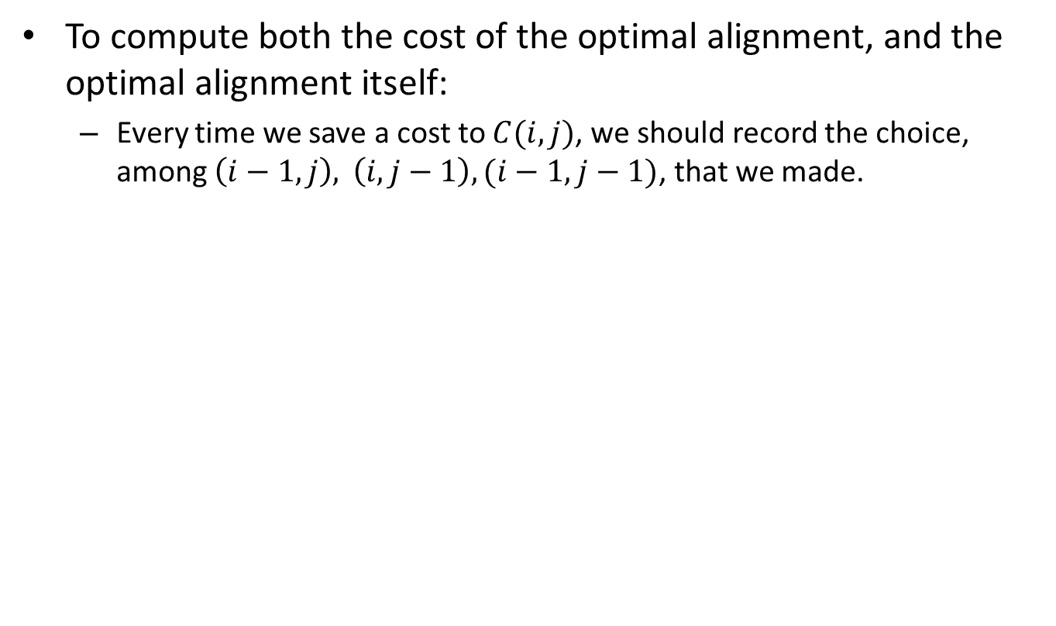
Cost vs. Alignment
To compute both the cost of the optimal alignment, and the optimal alignment itself:
Every time we save a cost to $C(i, j)$, we should record the choice, among $\left(i−1, j\right), \left(i, j−1\right),(i−1, j−1)$, that we made.

Slide 63
Example
The dynamically warped path between X and Y
Trace back to the neighboring cell that gave the minimum distance
Y
1
1
5
6
X
Y
10
5
1
2
1
0
X
11
5
5
2
3
1
11
6
14
6
1
3
0
2
Note: ${\left(1−0\right)}^{2}+{\left(1−1\right)}^{2}+{\left(3−3\right)}^{2}+{\left(1−2\right)}^{2}+{\left(0−2\right)}^{2}=6$

Slide 64
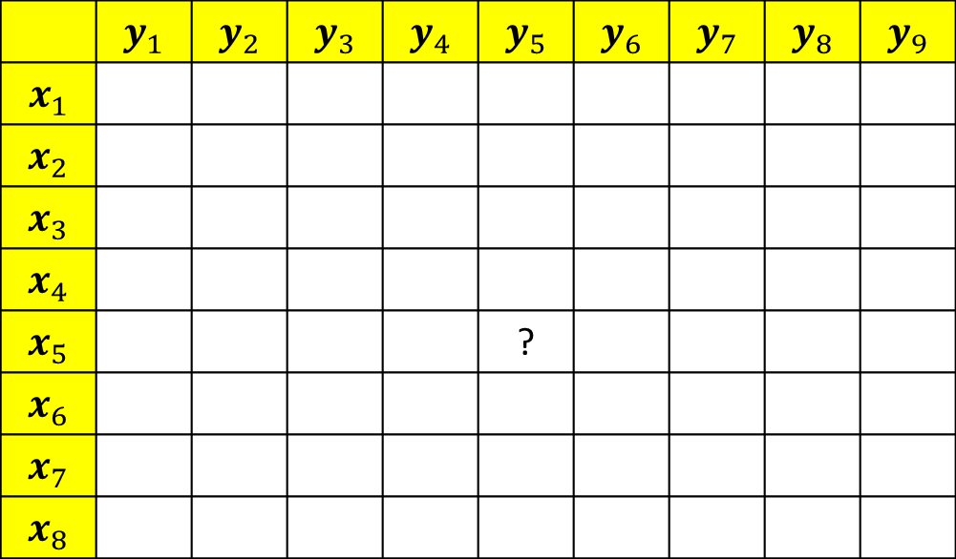
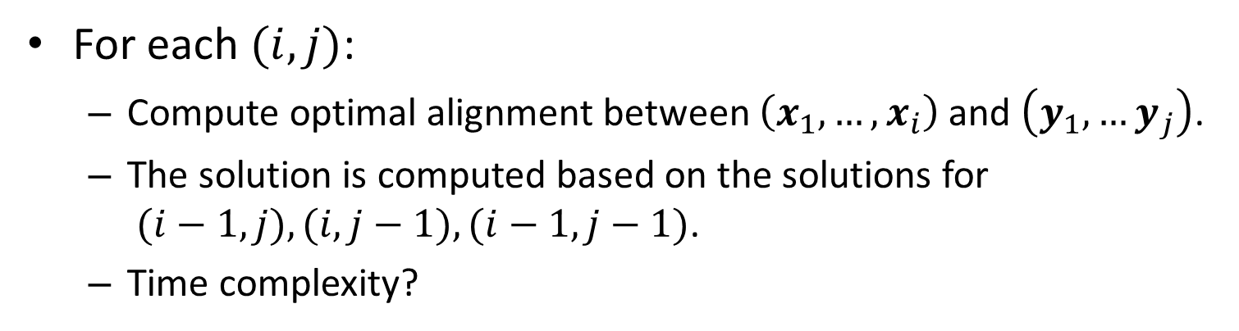
DTW Complexity
 | $$y_{1}$$ | $$y_{2}$$ | $$y_{3}$$ | $$y_{4}$$ | $$y_{5}$$ | $$y_{6}$$ | $$y_{7}$$ | $$y_{8}$$ | $$y_{9}$$
$$x_{1}$$
$$x_{2}$$
$$x_{3}$$
$$x_{4}$$
$$x_{5}$$ |  |  |  |  | ?
$$x_{6}$$
$$x_{7}$$
$$x_{8}$$
For each $(i,j)$:
Compute optimal alignment between $\left(x_{1}, …,x_{i}\right)$ and $\left(y_{1}, …y_{j}\right)$.
The solution is computed based on the solutions for $(i−1, j), (i, j−1), (i−1, j−1)$.
Time complexity?

Slide 65
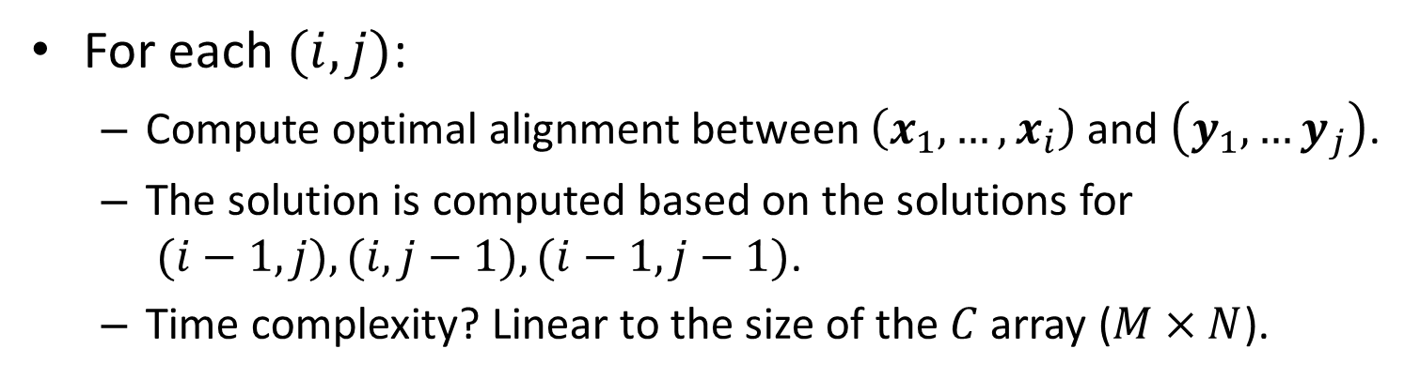
DTW Complexity
 | $$y_{1}$$ | $$y_{2}$$ | $$y_{3}$$ | $$y_{4}$$ | $$y_{5}$$ | $$y_{6}$$ | $$y_{7}$$ | $$y_{8}$$ | $$y_{9}$$
$$x_{1}$$
$$x_{2}$$
$$x_{3}$$
$$x_{4}$$
$$x_{5}$$ |  |  |  |  | ?
$$x_{6}$$
$$x_{7}$$
$$x_{8}$$
For each $(i,j)$:
Compute optimal alignment between $\left(x_{1}, …,x_{i}\right)$ and $\left(y_{1}, …y_{j}\right)$.
The solution is computed based on the solutions for $(i−1, j), (i, j−1), (i−1, j−1)$.
Time complexity? Linear to the size of the $C$ array ($M×N$).

Slide 66
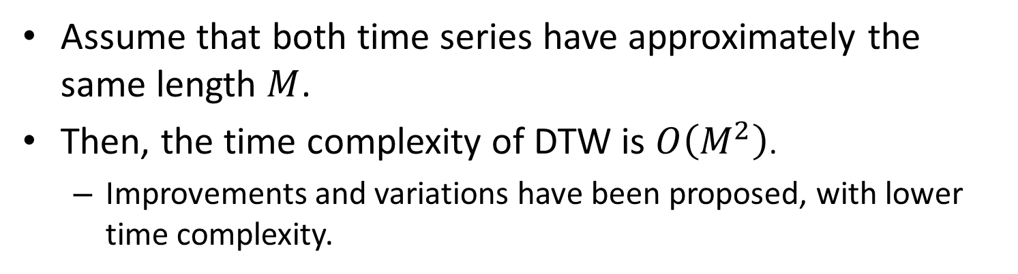
DTW Complexity
 | $$y_{1}$$ | $$y_{2}$$ | $$y_{3}$$ | $$y_{4}$$ | $$y_{5}$$ | $$y_{6}$$ | $$y_{7}$$ | $$y_{8}$$ | $$y_{9}$$
$$x_{1}$$
$$x_{2}$$
$$x_{3}$$
$$x_{4}$$
$$x_{5}$$ |  |  |  |  | ?
$$x_{6}$$
$$x_{7}$$
$$x_{8}$$
Assume that both time series have approximately the same length $M$.
Then, the time complexity of DTW is $O\left(M^{2}\right)$.
Improvements and variations have been proposed, with lower time complexity.

Slide 67
DTW-1NN
Time series classification using 1-Nearest Neighbor
Compute DTW distance between test time-series and all time-series in training data
Classify with label of time-series with minimum DTW distance
Works very well in practice
“Many algorithms have been proposed for the problem of time series classification. However, it is clear that one-nearest-neighbor with Dynamic Time Warping (DTW) distance is exceptionally difficult to beat”
Xi et al. Fast time series classification using numerosity reduction, ICML 2006

Slide 68
Dynamic Time Warping, Recap
It is oftentimes useful to use nearest neighbor classification to classify time series.
Especially when we have very few training examples per class, or, in the extreme, only one training example per class.
However, to use nearest neighbor classification, we need to define a meaningful distance measure between time series.
The Euclidean distance works poorly because even slight misalignments can lead to large distance values.
Dynamic Time Warping is based on computing an optimal alignment between two time series, and thus it can tolerate even large misalignments.
The complexity of Dynamic Time Warping is quadratic to the length of the time series, but more efficient variants can also be used.

Slide 69
Why does dtw work?
Optional slides with additional information

Slide 70
Visualizing a Warping Path
Warping path is an alternative term for an alignment

Slide 71
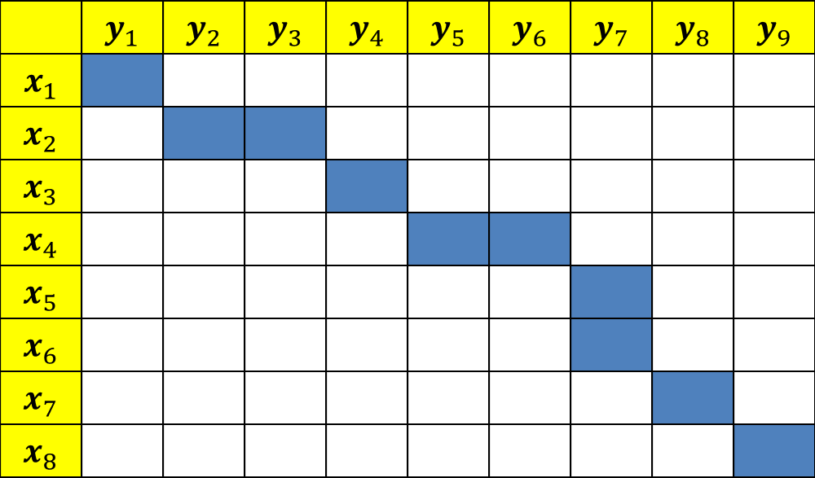
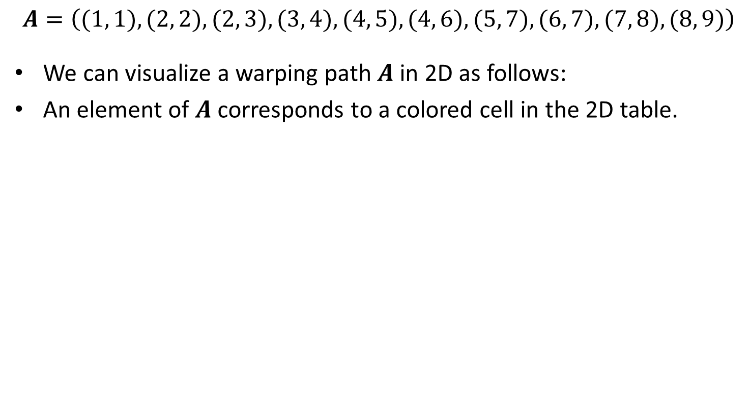
Visualizing a Warping Path
$$A=\left((1, 1), (2, 2), (2, 3), (3, 4), (4, 5), (4, 6), (5, 7), (6, 7), (7, 8), (8, 9)\right)$$
We can visualize a warping path $A$ in 2D as follows:
An element of $A$ corresponds to a colored cell in the 2D table.
 | $$y_{1}$$ | $$y_{2}$$ | $$y_{3}$$ | $$y_{4}$$ | $$y_{5}$$ | $$y_{6}$$ | $$y_{7}$$ | $$y_{8}$$ | $$y_{9}$$
$$x_{1}$$
$$x_{2}$$
$$x_{3}$$
$$x_{4}$$
$$x_{5}$$
$$x_{6}$$
$$x_{7}$$
$$x_{8}$$

Slide 72
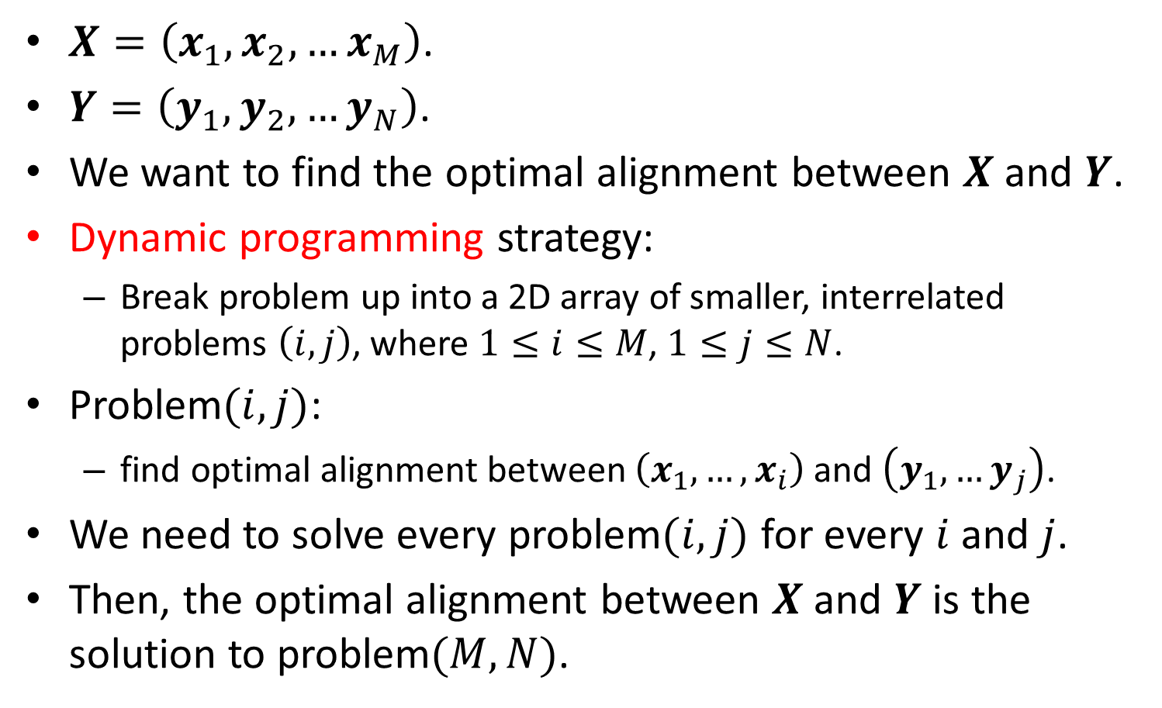
Finding the Optimal Alignment
$X=\left(x_{1},x_{2},…x_{M}\right)$.
$Y=\left(y_{1},y_{2},…y_{N}\right)$.
We want to find the optimal alignment between $X$ and $Y$.
Dynamic programming strategy:
Break problem up into a 2D array of smaller, interrelated problems $\left(i,j\right)$, where $1≤i≤M$, $1≤j≤N$.
Problem$(i,j)$:
find optimal alignment between $\left(x_{1}, …,x_{i}\right)$ and $\left(y_{1}, …y_{j}\right)$.
We need to solve every problem$(i,j)$ for every $i$ and $j$.
Then, the optimal alignment between $X$ and $Y$ is the solution to problem$(M,N)$.

Slide 73

Finding the Optimal Alignment
$X=\left(x_{1},x_{2},…x_{M}\right)$.
$Y=\left(y_{1},y_{2},…y_{N}\right)$.
We want to find the optimal alignment between $X$ and $Y$.
We break up the problem into a 2D array of smaller, interrelated problems $\left(i,j\right)$, where $1≤i≤M$, $1≤j≤N$.
Problem$(i,j)$:
find optimal alignment between $\left(x_{1}, …,x_{i}\right)$ and $\left(y_{1}, …y_{j}\right)$.
How do we start computing the optimal alignment?

Slide 74

Finding the Optimal Alignment
$X=\left(x_{1},x_{2},…x_{M}\right)$.
$Y=\left(y_{1},y_{2},…y_{N}\right)$.
We want to find the optimal alignment between $X$ and $Y$.
We break up the problem into a 2D array of smaller, interrelated problems $\left(i,j\right)$, where $1≤i≤M$, $1≤j≤N$.
Problem$(i,j)$:
find optimal alignment between $\left(x_{1}, …,x_{i}\right)$ and $\left(y_{1}, …y_{j}\right)$.
Solve problem$(1, 1)$:
How is problem$(1, 1)$ defined?

Slide 75

Finding the Optimal Alignment
$X=\left(x_{1},x_{2},…x_{M}\right)$.
$Y=\left(y_{1},y_{2},…y_{N}\right)$.
We want to find the optimal alignment between $X$ and $Y$.
We break up the problem into a 2D array of smaller, interrelated problems $\left(i,j\right)$, where $1≤i≤M$, $1≤j≤N$.
Problem$(i,j)$:
find optimal alignment between $\left(x_{1}, …,x_{i}\right)$ and $\left(y_{1}, …y_{j}\right)$.
Solve problem$(1, 1)$:
Find optimal alignment between $\left(x_{1}\right)$ and $\left(y_{1}\right)$.
What is the optimal alignment between $\left(x_{1}\right)$ and $\left(y_{1}\right)$?

Slide 76

Finding the Optimal Alignment
$X=\left(x_{1},x_{2},…x_{M}\right)$.
$Y=\left(y_{1},y_{2},…y_{N}\right)$.
We want to find the optimal alignment between $X$ and $Y$.
We break up the problem into a 2D array of smaller, interrelated problems $\left(i,j\right)$, where $1≤i≤M$, $1≤j≤N$.
Problem$(i,j)$:
find optimal alignment between $\left(x_{1}, …,x_{i}\right)$ and $\left(y_{1}, …y_{j}\right)$.
Solve problem$(1, 1)$:
Find optimal alignment between $\left(x_{1}\right)$ and $\left(y_{1}\right)$.
The optimal alignment is the only legal alignment: $\left((1, 1)\right)$.

Slide 77



Alignment for Problem $(1, 1)$
$$A=\left((1, 1) \right)$$
 | $$y_{1}$$ | $$y_{2}$$ | $$y_{3}$$ | $$y_{4}$$ | $$y_{5}$$ | $$y_{6}$$ | $$y_{7}$$ | $$y_{8}$$ | $$y_{9}$$
$$x_{1}$$
$$x_{2}$$
$$x_{3}$$
$$x_{4}$$
$$x_{5}$$
$$x_{6}$$
$$x_{7}$$
$$x_{8}$$

Slide 78

Finding the Optimal Alignment
$X=\left(x_{1},x_{2},…x_{M}\right)$.
$Y=\left(y_{1},y_{2},…y_{N}\right)$.
We want to find the optimal alignment between $X$ and $Y$.
We break up the problem into a 2D array of smaller, interrelated problems $\left(i,j\right)$, where $1≤i≤M$, $1≤j≤N$.
Problem$(i,j)$:
find optimal alignment between $\left(x_{1}, …,x_{i}\right)$ and $\left(y_{1}, …y_{j}\right)$.
Solve problem$(1, j)$:
How is problem$(1, j)$ defined?

Slide 79

Finding the Optimal Alignment
$X=\left(x_{1},x_{2},…x_{M}\right)$.
$Y=\left(y_{1},y_{2},…y_{N}\right)$.
We want to find the optimal alignment between $X$ and $Y$.
We break up the problem into a 2D array of smaller, interrelated problems $\left(i,j\right)$, where $1≤i≤M$, $1≤j≤N$.
Problem$(i,j)$:
find optimal alignment between $\left(x_{1}, …,x_{i}\right)$ and $\left(y_{1}, …y_{j}\right)$.
Solve problem$(1, j)$:
Find optimal alignment between $\left(x_{1}\right)$ and $\left(y_{1}, …y_{j}\right)$.
What is the optimal alignment between $\left(x_{1}\right)$ and $\left(y_{1},…,y_{j}\right)$?

Slide 80

Finding the Optimal Alignment
$X=\left(x_{1},x_{2},…x_{M}\right)$.
$Y=\left(y_{1},y_{2},…y_{N}\right)$.
We want to find the optimal alignment between $X$ and $Y$.
We break up the problem into a 2D array of smaller, interrelated problems $\left(i,j\right)$, where $1≤i≤M$, $1≤j≤N$.
Problem$(i,j)$:
find optimal alignment between $\left(x_{1}, …,x_{i}\right)$ and $\left(y_{1}, …y_{j}\right)$.
Solve problem$(1, j)$:
Find optimal alignment between $\left(x_{1}\right)$ and $\left(y_{1}, …y_{j}\right)$.
Optimal alignment: $\left((1, 1), (1, 2), …, (1, j)\right)$.
Here, $x_{1}$ is matched with each of the first $j$ elements of $Y$.

Slide 81


Alignment for Problem $(1, 5)$
$$A=\left((1, 1), (1,2), (1,3), (1,4), (1,5)\right)$$
 | $$y_{1}$$ | $$y_{2}$$ | $$y_{3}$$ | $$y_{4}$$ | $$y_{5}$$ | $$y_{6}$$ | $$y_{7}$$ | $$y_{8}$$ | $$y_{9}$$
$$x_{1}$$
$$x_{2}$$
$$x_{3}$$
$$x_{4}$$
$$x_{5}$$
$$x_{6}$$
$$x_{7}$$
$$x_{8}$$

Slide 82

Finding the Optimal Alignment
$X=\left(x_{1},x_{2},…x_{M}\right)$.
$Y=\left(y_{1},y_{2},…y_{N}\right)$.
We want to find the optimal alignment between $X$ and $Y$.
We break up the problem into a 2D array of smaller, interrelated problems $\left(i,j\right)$, where $1≤i≤M$, $1≤j≤N$.
Problem$(i,j)$:
find optimal alignment between $\left(x_{1}, …,x_{i}\right)$ and $\left(y_{1}, …y_{j}\right)$.
Solve problem$(i, 1)$:
How is problem$(i, 1)$ defined?

Slide 83

Finding the Optimal Alignment
$X=\left(x_{1},x_{2},…x_{M}\right)$.
$Y=\left(y_{1},y_{2},…y_{N}\right)$.
We want to find the optimal alignment between $X$ and $Y$.
We break up the problem into a 2D array of smaller, interrelated problems $\left(i,j\right)$, where $1≤i≤M$, $1≤j≤N$.
Problem$(i,j)$:
find optimal alignment between $\left(x_{1}, …,x_{i}\right)$ and $\left(y_{1}, …y_{j}\right)$.
Solve problem$(i, 1)$:
Find optimal alignment between $\left(x_{1},…x_{i}\right)$ and $\left(y_{1}\right)$.
What is the optimal alignment between $\left(x_{1},…x_{i}\right)$ and $\left(y_{1}\right)$?

Slide 84

Finding the Optimal Alignment
$X=\left(x_{1},x_{2},…x_{M}\right)$.
$Y=\left(y_{1},y_{2},…y_{N}\right)$.
We want to find the optimal alignment between $X$ and $Y$.
We break up the problem into a 2D array of smaller, interrelated problems $\left(i,j\right)$, where $1≤i≤M$, $1≤j≤N$.
Problem$(i,j)$:
find optimal alignment between $\left(x_{1}, …,x_{i}\right)$ and $\left(y_{1}, …y_{j}\right)$.
Solve problem$(i, 1)$:
Find optimal alignment between $\left(x_{1},…x_{i}\right)$ and $\left(y_{1}\right)$.
Optimal alignment: $\left((1, 1), (2, 1), …, (i, 1)\right)$.
Here, $y_{1}$ is matched with each of the first $i$ elements of $X$.

Slide 85


Alignment for Problem $(5, 1)$
$$A=\left((1, 1), (2, 1), (3, 1), (4, 1), (5, 1)\right)$$
 | $$y_{1}$$ | $$y_{2}$$ | $$y_{3}$$ | $$y_{4}$$ | $$y_{5}$$ | $$y_{6}$$ | $$y_{7}$$ | $$y_{8}$$ | $$y_{9}$$
$$x_{1}$$
$$x_{2}$$
$$x_{3}$$
$$x_{4}$$
$$x_{5}$$
$$x_{6}$$
$$x_{7}$$
$$x_{8}$$

Slide 86

Finding the Optimal Alignment
$Y=\left(y_{1},y_{2},…y_{N}\right)\text{. }$
$X=\left(x_{1},x_{2},…x_{M}\right)$.
We want to find the optimal alignment between $X$ and $Y$.
We break up the problem into a 2D array of smaller, interrelated problems $\left(i,j\right)$, where $1≤i≤M$, $1≤j≤N$.
Problem$(i,j)$:
find optimal alignment between $\left(x_{1}, …,x_{i}\right)$ and $\left(y_{1}, …y_{j}\right)$.
Solve problem$(i, j)$:
Here is where dynamic programming comes into play.
The solution can be obtained from the solutions to problem$\left(i, j−1\right)$, problem$(i−1, j)$, problem$(i−1, j−1)$.

Slide 87

Finding the Optimal Alignment
Solving problem$(i, j)$:
Look at the following three alignments:
Let $A_{i,j−1}$ be the solution to problem$\left(i, j−1\right).$
Let $A_{i−1,j}$ be the solution to problem$\left(i−1, j\right)$.
Let $A_{i−1,j−1}$ be the solution to problem$(i−1, j−1)$.
Let ${A^{∗}}_{i,j}$ be the alignment among $A_{i,j−1}$, $A_{i,j−1}$, and $A_{i−1,j−1}$ with the smallest cost.
Then, the solution to problem$\left(i, j\right)$ is obtained by appending pair $\left(i, j\right)$ to the end of ${A^{∗}}_{i,j}$.

